Slide 1
Smooth min-entropy lower bounds for approximation chains
Presentation for Beyond i.i.d 2023
Ashutosh Marwah
(work with Frédéric Dupuis)
Université de Montréal
github.com/goforashutosh/approx-chains

Slide 2
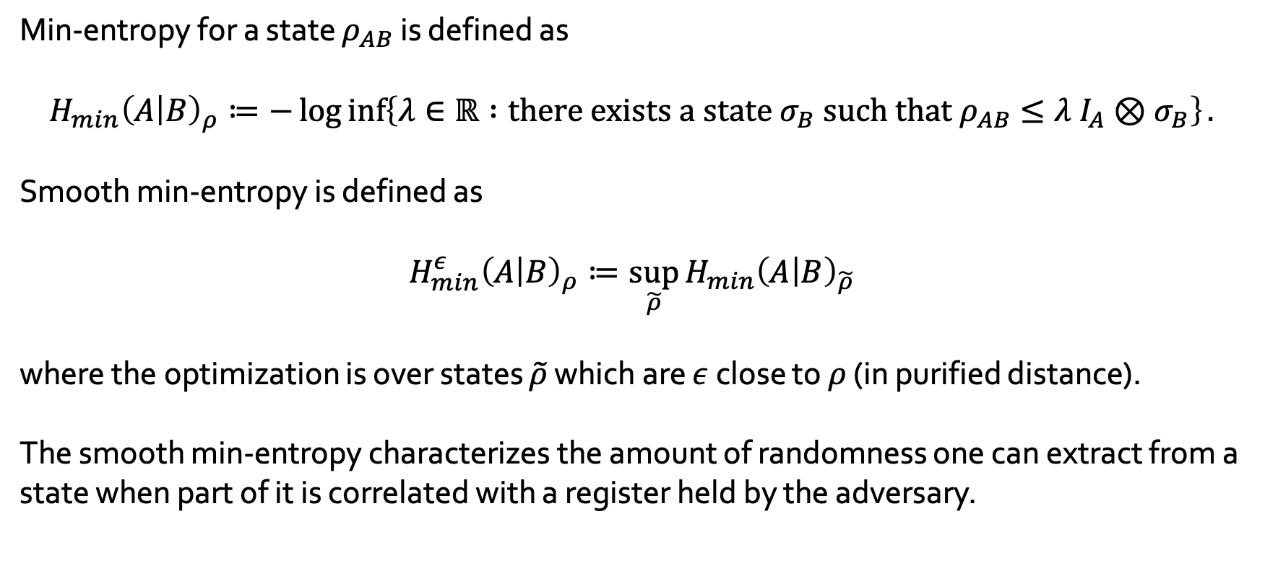
Smooth min-entropy
Min-entropy for a state $ρ_{AB}$ is defined as
$$H_{min}{\left(A | B\right)}_{ρ}≔−\log{\inf\left\{λ∈ℝ :{\text{there} \text{exists} \text{a} \text{state} σ_{B} \text{such} \text{that} ρ}_{AB}≤λ I_{A}⊗σ_{B}\right\}}.$$
Smooth min-entropy is defined as
$$H_{min}^{ε}{\left(A | B\right)}_{ρ}≔\sup_{\tilde{ρ}}{H_{min}{\left(A | B\right)}_{\tilde{ρ}}}$$
where the optimization is over states $\tilde{ρ}$ which are $ε$ close to $ρ$ (in purified distance).
The smooth min-entropy characterizes the amount of randomness one can extract from a state when part of it is correlated with a register held by the adversary.

Slide 3
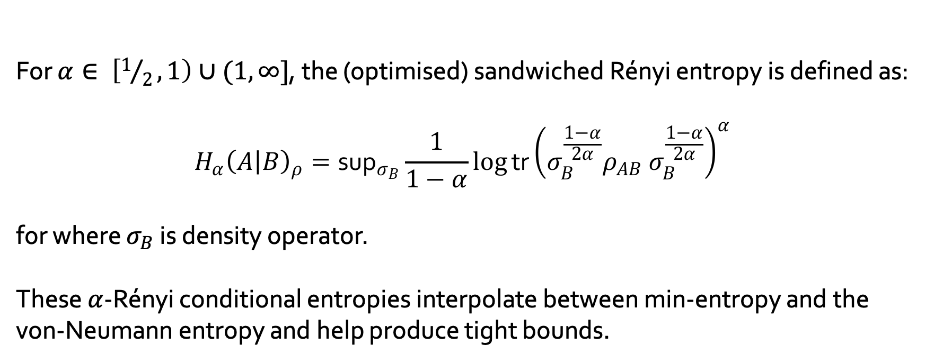
Rényi entropies
For $α∈ \left[1/2, 1\right)∪(1, ∞]$, the (optimised) sandwiched Rényi entropy is defined as:
$$H_{α}{\left(A | B\right)}_{ρ}=\text{su}{\text{p}}_{σ_{B}}\frac{1}{1−α}log{\text{tr}}{\left(σ_{B}^{\frac{1−α}{2α}}{ρ_{AB} σ}_{B}^{\frac{1−α}{2α}}\right)}^{α}$$
for where $σ_{B}$ is density operator.
These $α$-Rényi conditional entropies interpolate between min-entropy and the von-Neumann entropy and help produce tight bounds.

Slide 4
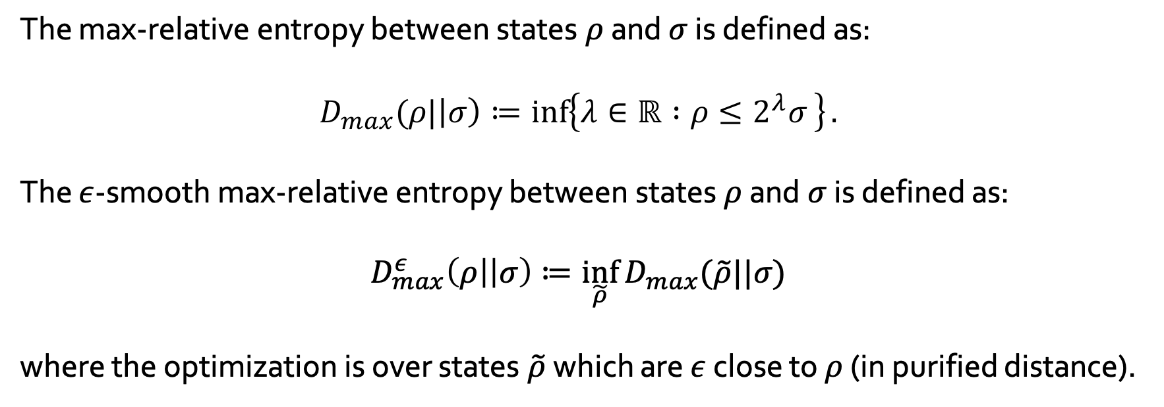
Smooth max-relative entropy
The max-relative entropy between states $ρ$ and $σ$ is defined as:
$$D_{max}(ρ|\left|σ\right)≔\inf\left\{λ∈ℝ :ρ≤2^{λ}σ \right\}.$$
The $ε$-smooth max-relative entropy between states $ρ$ and $σ$ is defined as:
$$D_{max}^{ε}\left(ρ\right|\left|σ\right)≔\inf_{\tilde{ρ}}{D_{max}(\tilde{ρ}||σ)}$$
where the optimization is over states $\tilde{ρ}$ which are $ε$ close to $ρ$ (in purified distance).

Slide 5
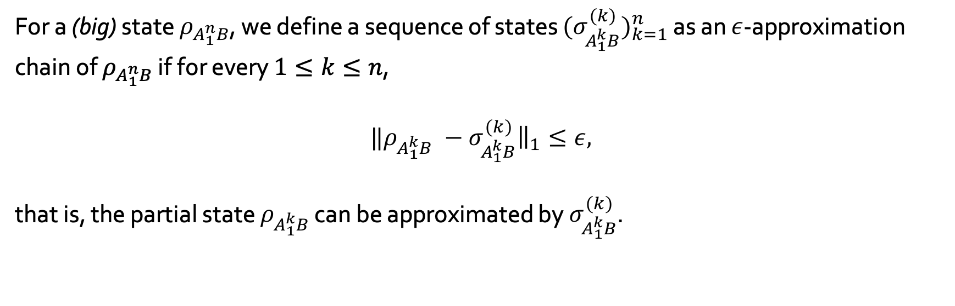
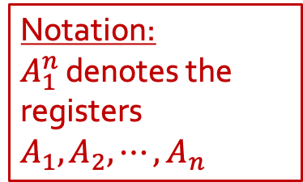
Approximation chains
For a (big) state $ρ_{A_{1}^{n}B}$, we define a sequence of states ${{(σ}_{A_{1}^{k}B}^{\left(k\right)})}_{k=1}^{n}$ as an $ε$-approximation chain of $ρ_{A_{1}^{n}B}$ if for every $1≤k≤n$,
$$‖ρ_{A_{1}^{k}B} −σ_{A_{1}^{k}B}^{\left(k\right)}{\left.​\right\|}_{1}≤ε,$$
that is, the partial state $ρ_{A_{1}^{k}B}$ can be approximated by $σ_{A_{1}^{k}B}^{\left(k\right)}$.
Notation:
$A_{1}^{n}$ denotes the registers $A_{1},A_{2}, ⋯,A_{n}$

Slide 6
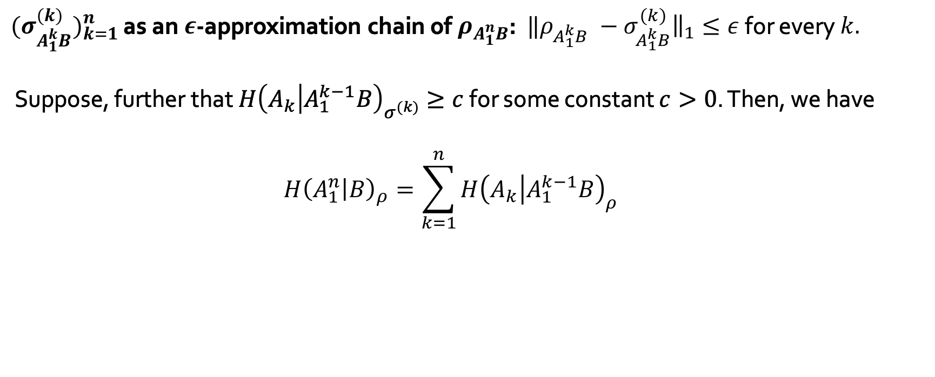
Approximation chains
${{(σ}_{A_{1}^{k}B}^{\left(k\right)})}_{k=1}^{n}$ as an $ε$-approximation chain of $ρ_{A_{1}^{n}B}$: $‖ρ_{A_{1}^{k}B} −σ_{A_{1}^{k}B}^{\left(k\right)}{\left.​\right\|}_{1}≤ε$ for every $k.$
Suppose, further that $H{\left(A_{k} | A_{1}^{k−1}B\right)}_{σ^{(k)}}≥c$ for some constant $c>0$. Then, we have
$$H{\left(A_{1}^{n} | B\right)}_{ρ}=\sum_{k=1}^{n}{H{\left(A_{k} | A_{1}^{k−1}B\right)}_{ρ}} \\ ≥\sum_{k=1}^{n}{H{\left(A_{k} | A_{1}^{k−1}B\right)}_{σ^{\left(k\right)}}} −g\left(ε, \left|A\right|\right) \\ ≥n(c−g(ε, \left|A\right|)$$

Slide 7
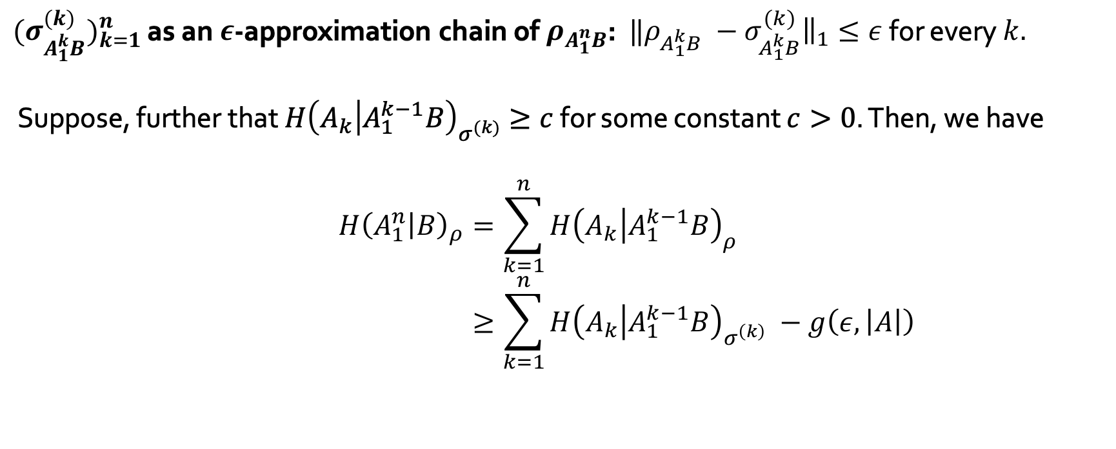
Approximation chains
${{(σ}_{A_{1}^{k}B}^{\left(k\right)})}_{k=1}^{n}$ as an $ε$-approximation chain of $ρ_{A_{1}^{n}B}$: $‖ρ_{A_{1}^{k}B} −σ_{A_{1}^{k}B}^{\left(k\right)}{\left.​\right\|}_{1}≤ε$ for every $k.$
Suppose, further that $H{\left(A_{k} | A_{1}^{k−1}B\right)}_{σ^{(k)}}≥c$ for some constant $c>0$. Then, we have
$$H{\left(A_{1}^{n} | B\right)}_{ρ}=\sum_{k=1}^{n}{H{\left(A_{k} | A_{1}^{k−1}B\right)}_{ρ}} \\ ≥\sum_{k=1}^{n}{H{\left(A_{k} | A_{1}^{k−1}B\right)}_{σ^{\left(k\right)}}} −g\left(ε, \left|A\right|\right) \\ ≥n(c−g(ε, \left|A\right|)$$

Slide 8
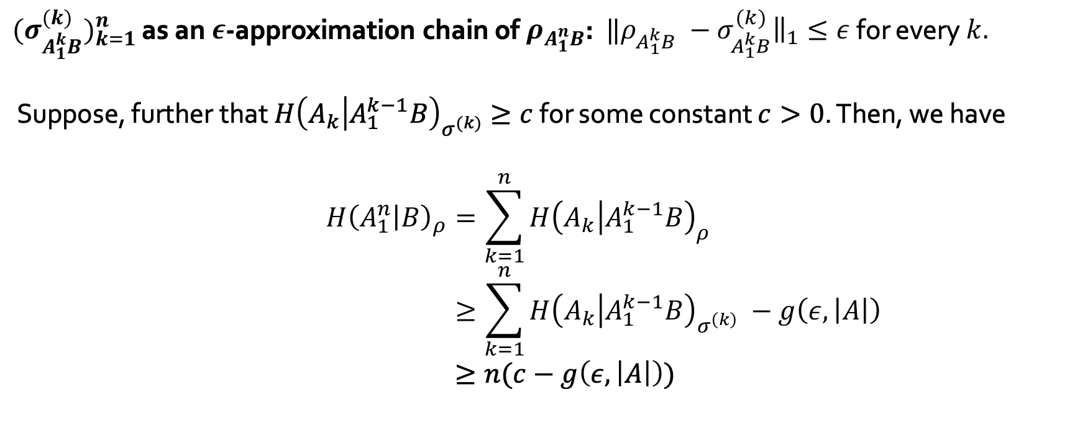
Approximation chains
${{(σ}_{A_{1}^{k}B}^{\left(k\right)})}_{k=1}^{n}$ as an $ε$-approximation chain of $ρ_{A_{1}^{n}B}$: $‖ρ_{A_{1}^{k}B} −σ_{A_{1}^{k}B}^{\left(k\right)}{\left.​\right\|}_{1}≤ε$ for every $k.$
Suppose, further that $H{\left(A_{k} | A_{1}^{k−1}B\right)}_{σ^{(k)}}≥c$ for some constant $c>0$. Then, we have
$$H{\left(A_{1}^{n} | B\right)}_{ρ}=\sum_{k=1}^{n}{H{\left(A_{k} | A_{1}^{k−1}B\right)}_{ρ}} \\ ≥\sum_{k=1}^{n}{H{\left(A_{k} | A_{1}^{k−1}B\right)}_{σ^{\left(k\right)}}} −g\left(ε, \left|A\right|\right) \\ ≥n(c−g\left(ε, \left|A\right|\right))$$

Slide 9
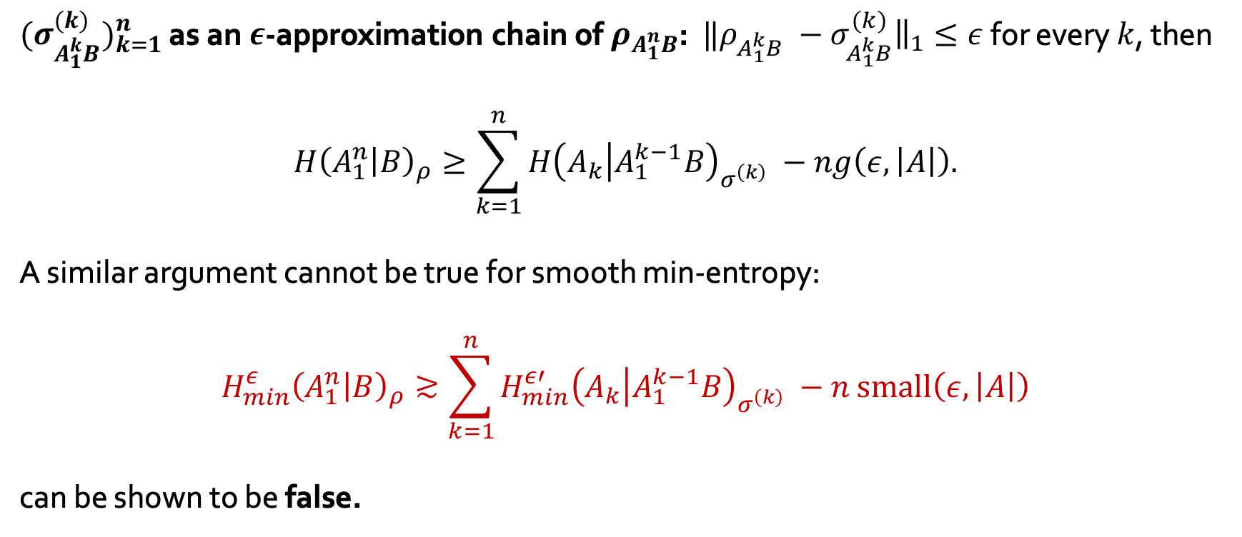
Approximation chains
${{(σ}_{A_{1}^{k}B}^{\left(k\right)})}_{k=1}^{n}$ as an $ε$-approximation chain of $ρ_{A_{1}^{n}B}$: $‖ρ_{A_{1}^{k}B} −σ_{A_{1}^{k}B}^{\left(k\right)}{\left.​\right\|}_{1}≤ε$ for every $k$, then
$$H{\left(A_{1}^{n} | B\right)}_{ρ}≥\sum_{k=1}^{n}{H{\left(A_{k} | A_{1}^{k−1}B\right)}_{σ^{\left(k\right)}}} −ng\left(ε, \left|A\right|\right).$$
A similar argument cannot be true for smooth min-entropy:
$$H_{min}^{ε}{\left(A_{1}^{n} | B\right)}_{ρ}≳\sum_{k=1}^{n}{H_{min}^{ε′}{\left(A_{k} | A_{1}^{k−1}B\right)}_{σ^{\left(k\right)}}} −n \text{small}\left(ε, \left|A\right|\right)$$
can be shown to be false.

Slide 10
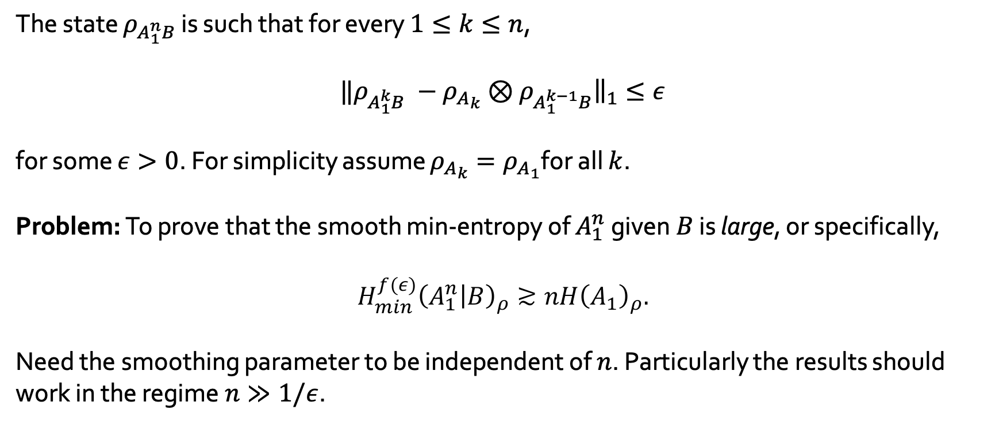
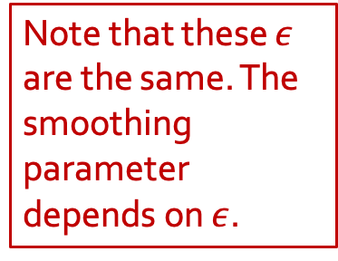
Approximate independence
The state $ρ_{A_{1}^{n}B}$ is such that for every $1≤k≤n$,
$$‖ρ_{A_{1}^{k}B} −{ρ_{A_{k}}⊗ρ}_{A_{1}^{k−1}B}{\left.​\right\|}_{1}≤ε$$
for some $ε>0$. For simplicity assume $ρ_{A_{k}}=ρ_{A_{1}}$for all $k$.
Problem: To prove that the smooth min-entropy of $A_{1}^{n}$ given $B$ is large, or specifically,
$$H_{min}^{f(ε)}{\left(A_{1}^{n} | B\right)}_{ρ}≳nH{\left(A_{1}\right)}_{ρ}.$$
Need the smoothing parameter to be independent of $n$. Particularly the results should work in the regime $n≫1/ε$.
Note that these $ε$ are the same. The smoothing parameter depends on $ε$.

Slide 11
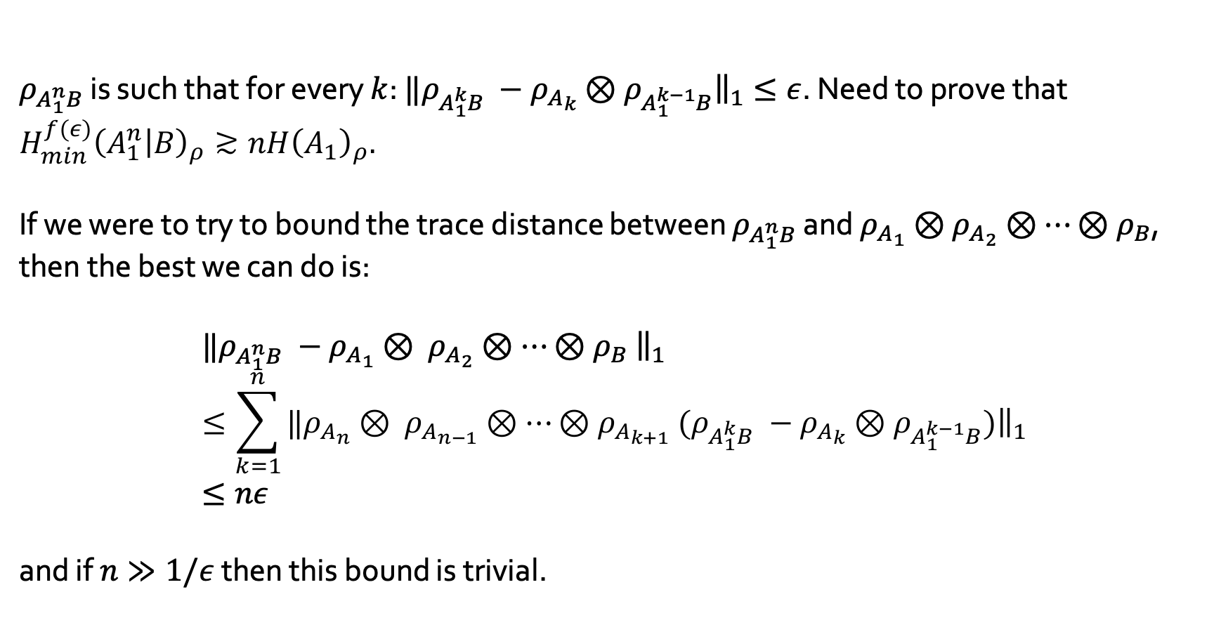
Approximate independence: triangle inequality
$ρ_{A_{1}^{n}B}$ is such that for every $k$: $‖ρ_{A_{1}^{k}B} −{ρ_{A_{k}}⊗ρ}_{A_{1}^{k−1}B}{\left.​\right\|}_{1}≤ε$. Need to prove that $H_{min}^{f(ε)}{\left(A_{1}^{n} | B\right)}_{ρ}≳nH{\left(A_{1}\right)}_{ρ}.$
If we were to try to bound the trace distance between $ρ_{A_{1}^{n}B}$ and $ρ_{A_{1}}⊗$ $ρ_{A_{2}}⊗⋯{⊗ρ}_{B}$, then the best we can do is:
$$‖ρ_{A_{1}^{n}B} −ρ_{A_{1}}⊗ ρ_{A_{2}}⊗⋯{⊗ρ}_{B}{\left.​\right\|}_{1}≤\sum_{k=1}^{n}{‖{ρ_{A_{n}}⊗ ρ_{A_{n−1}}⊗⋯{⊗ρ}_{A_{k+1}}(ρ}_{A_{1}^{k}B} −{ρ_{A_{k}}⊗ρ}_{A_{1}^{k−1}B}{\left.)​\right\|}_{1}} \\ ≤nε$$
and if $n≫1/ε$ then this bound is trivial.

Slide 12
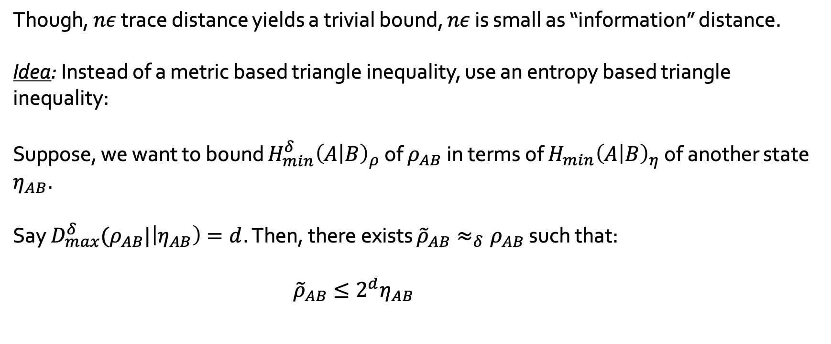
Entropic triangle inequality
Though, $nε$ trace distance yields a trivial bound, $nε$ is small as “information” distance.
Idea: Instead of a metric based triangle inequality, use an entropy based triangle inequality:
Suppose, we want to bound $H_{min}^{δ}{\left(A | B\right)}_{ρ}$ of $ρ_{AB}$in terms of $H_{min}{\left(A | B\right)}_{η}$ of another state $η_{AB}$.
Say $D_{max}^{δ}(ρ_{AB}|\left|η_{AB}\right)=d$. Then, there exists ${\tilde{ρ}}_{AB}≈_{δ}ρ_{AB}$ such that:
$${\tilde{ρ}}_{AB}≤2^{d}η_{AB} \\ ≤2^{d }2^{−H_{min}{\left(A | B\right)}_{η}} I_{A}⊗σ_{B}$$

Slide 13
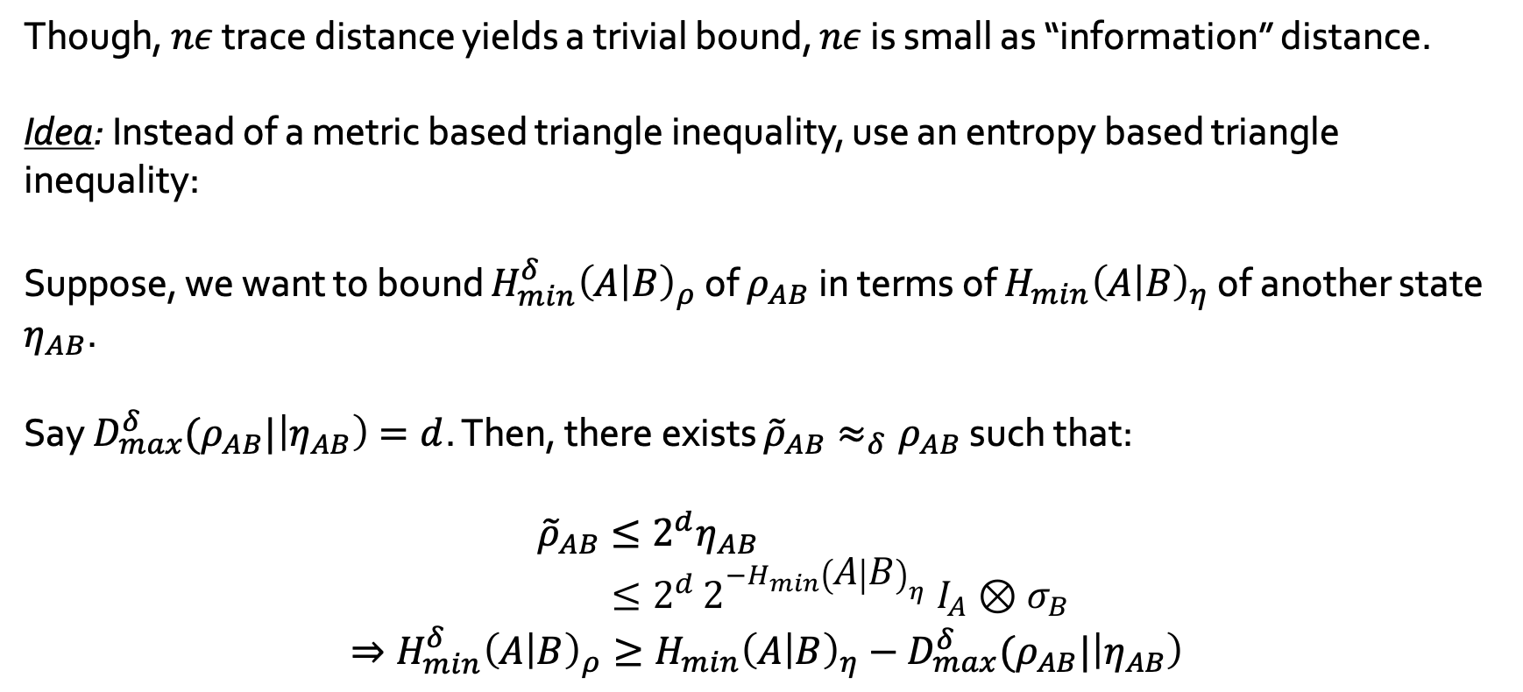
Entropic triangle inequality
Though, $nε$ trace distance yields a trivial bound, $nε$ is small as “information” distance.
Idea: Instead of a metric based triangle inequality, use an entropy based triangle inequality:
Suppose, we want to bound $H_{min}^{δ}{\left(A | B\right)}_{ρ}$ of $ρ_{AB}$in terms of $H_{min}{\left(A | B\right)}_{η}$ of another state $η_{AB}$.
Say $D_{max}^{δ}(ρ_{AB}|\left|η_{AB}\right)=d$. Then, there exists ${\tilde{ρ}}_{AB}≈_{δ}ρ_{AB}$ such that:
$${\tilde{ρ}}_{AB}≤2^{d}η_{AB} \\ ≤2^{d }2^{−H_{min}{\left(A | B\right)}_{η}} I_{A}⊗σ_{B}$$
$$⇒H_{min}^{δ}{\left(A | B\right)}_{ρ}≥H_{min}{\left(A | B\right)}_{η}−D_{max}^{δ}(ρ_{AB}|\left|η_{AB}\right)$$

Slide 14
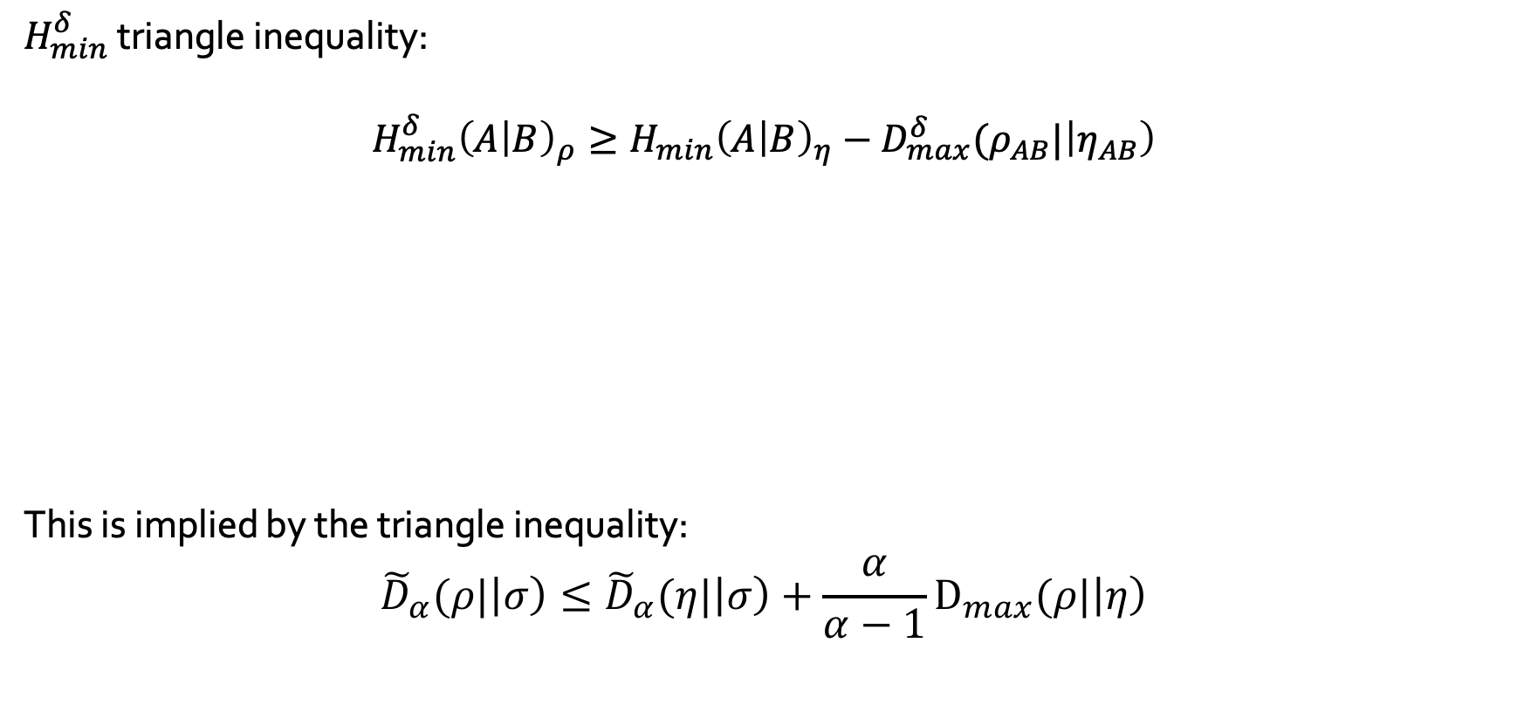
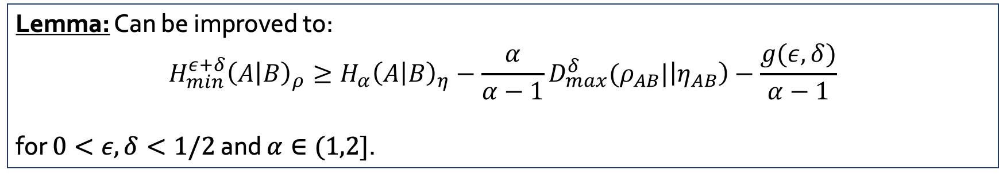
Entropic triangle inequality
$H_{min}^{δ}$ triangle inequality:
$$H_{min}^{δ}{\left(A | B\right)}_{ρ}≥H_{min}{\left(A | B\right)}_{η}−D_{max}^{δ}(ρ_{AB}|\left|η_{AB}\right)$$
This is implied by the triangle inequality:
$${\tilde{D}}_{α}(ρ|\left|σ\right)≤{\tilde{D}}_{α}(η|\left|σ\right)+\frac{α}{α−1}D_{max}(ρ|\left|η\right)$$
Lemma: Can be improved to:
$$H_{min}^{ε+δ}{\left(A | B\right)}_{ρ}≥H_{α}{\left(A | B\right)}_{η}−{\frac{α}{α−1}D}_{max}^{δ}(ρ_{AB}|\left|η_{AB}\right)−\frac{g(ε,δ)}{α−1}$$
for $0<ε,δ<1/2$ and $α∈(1,2]$.

Slide 15
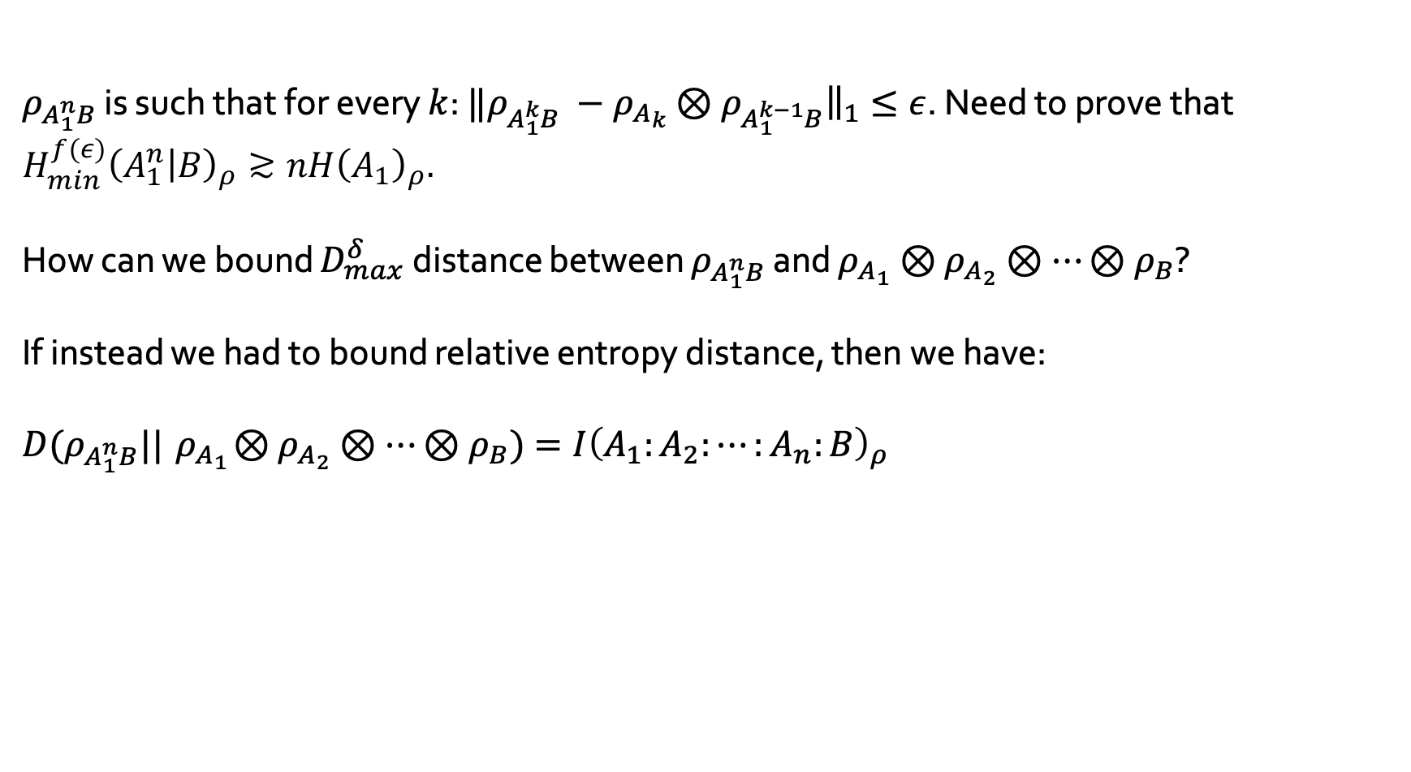
Approximate independence
$ρ_{A_{1}^{n}B}$ is such that for every $k$: $‖ρ_{A_{1}^{k}B} −{ρ_{A_{k}}⊗ρ}_{A_{1}^{k−1}B}{\left.​\right\|}_{1}≤ε$. Need to prove that $H_{min}^{f(ε)}{\left(A_{1}^{n} | B\right)}_{ρ}≳nH{\left(A_{1}\right)}_{ρ}.$
How can we bound $D_{max}^{δ}$ distance between $ρ_{A_{1}^{n}B}$ and $ρ_{A_{1}}⊗$ $ρ_{A_{2}}⊗⋯{⊗ρ}_{B}$?
If instead we had to bound relative entropy distance, then we have:
$$D(ρ_{A_{1}^{n}B}||{ ρ}_{A_{1}}⊗ρ_{A_{2}}⊗⋯{⊗ρ}_{B})=I{\left(A_{1}:A_{2}:⋯:A_{n}:B\right)}_{ρ} \\ =\sum_{k=1}^{n}{I{\left(A_{k}:A_{1}^{k−1}B\right)}_{ρ}} \\ ≤\sum_{k=1}^{n}{I{\left(A_{k}:A_{1}^{k−1}B\right)}_{{ρ_{A_{k}}⊗ρ}_{A_{1}^{k−1}B}}+f(ε, \left|A\right|) }$$

Slide 16
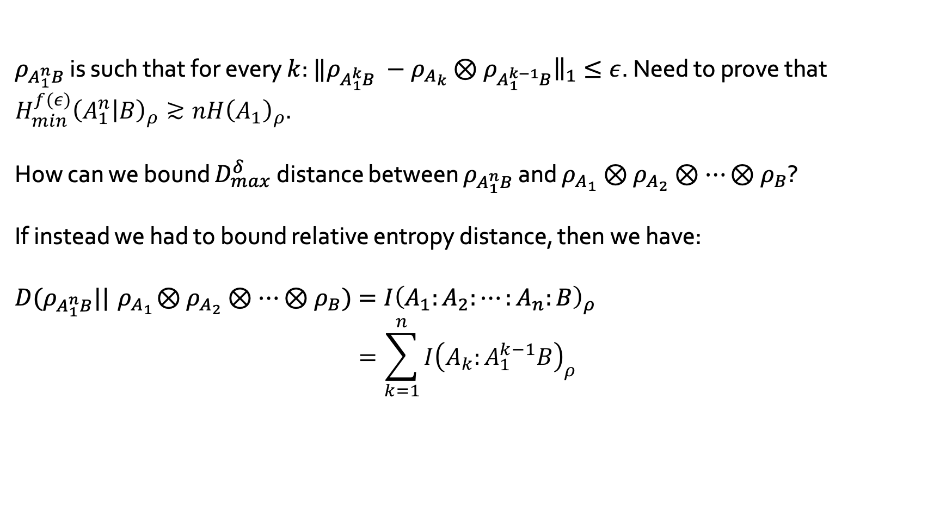
Approximate independence
$ρ_{A_{1}^{n}B}$ is such that for every $k$: $‖ρ_{A_{1}^{k}B} −{ρ_{A_{k}}⊗ρ}_{A_{1}^{k−1}B}{\left.​\right\|}_{1}≤ε$. Need to prove that $H_{min}^{f(ε)}{\left(A_{1}^{n} | B\right)}_{ρ}≳nH{\left(A_{1}\right)}_{ρ}.$
How can we bound $D_{max}^{δ}$ distance between $ρ_{A_{1}^{n}B}$ and $ρ_{A_{1}}⊗$ $ρ_{A_{2}}⊗⋯{⊗ρ}_{B}$?
If instead we had to bound relative entropy distance, then we have:
$$D(ρ_{A_{1}^{n}B}||{ ρ}_{A_{1}}⊗ρ_{A_{2}}⊗⋯{⊗ρ}_{B})=I{\left(A_{1}:A_{2}:⋯:A_{n}:B\right)}_{ρ} \\ =\sum_{k=1}^{n}{I{\left(A_{k}:A_{1}^{k−1}B\right)}_{ρ}} \\ ≤\sum_{k=1}^{n}{I{\left(A_{k}:A_{1}^{k−1}B\right)}_{{ρ_{A_{k}}⊗ρ}_{A_{1}^{k−1}B}}+f(ε, \left|A\right|) }$$

Slide 17
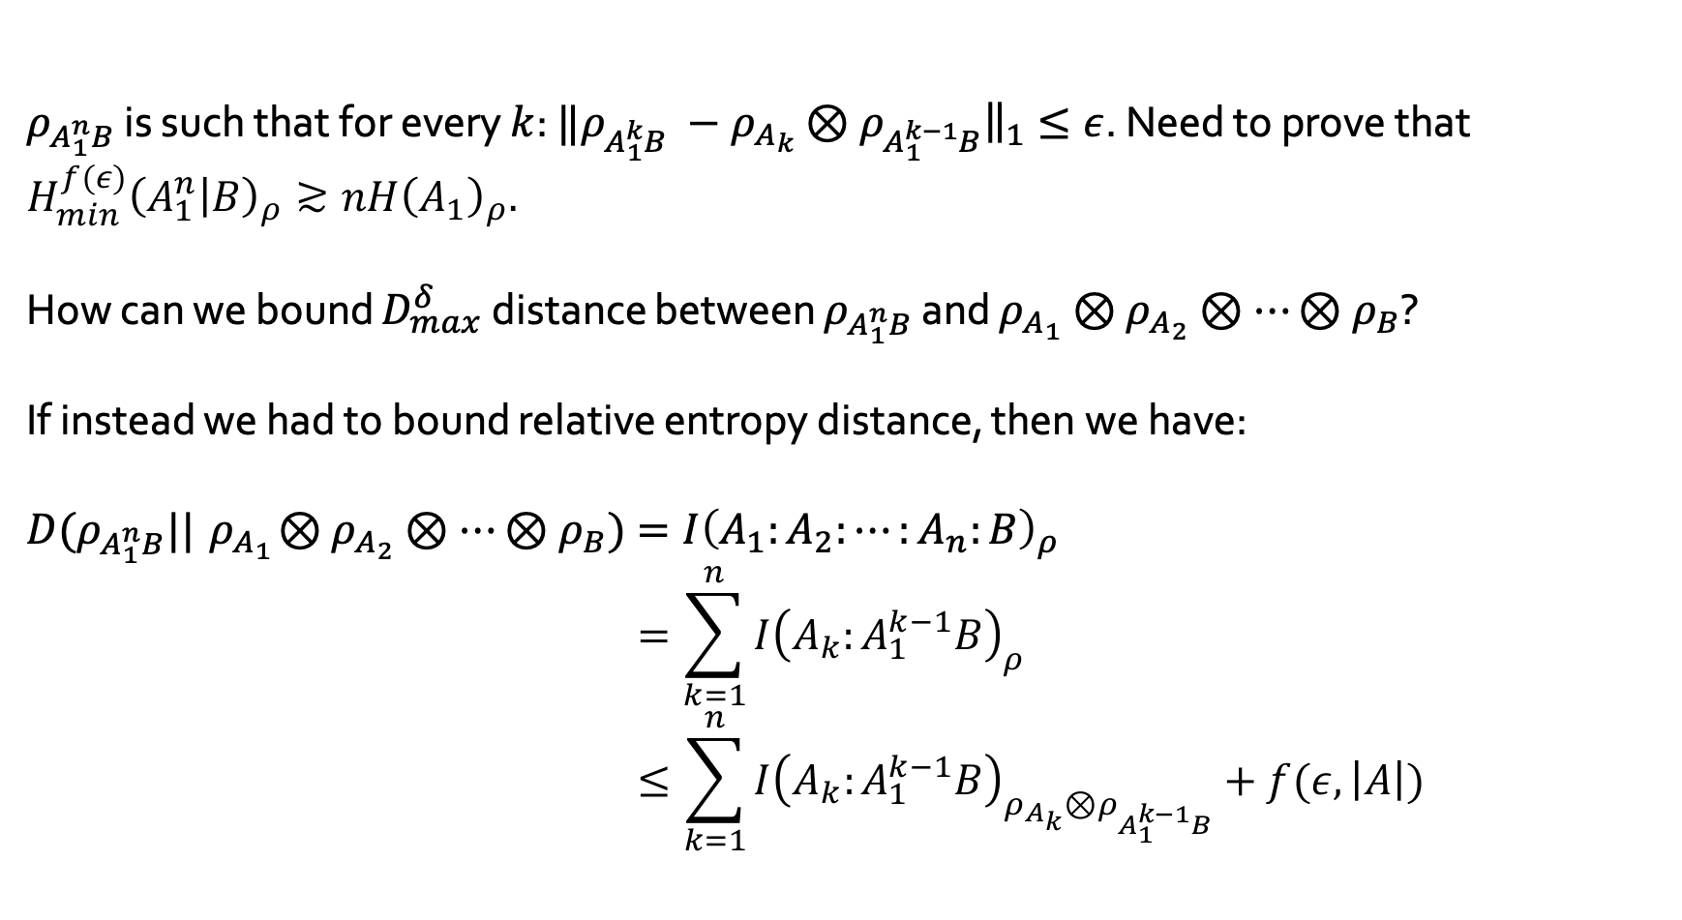
Approximate independence
$ρ_{A_{1}^{n}B}$ is such that for every $k$: $‖ρ_{A_{1}^{k}B} −{ρ_{A_{k}}⊗ρ}_{A_{1}^{k−1}B}{\left.​\right\|}_{1}≤ε$. Need to prove that $H_{min}^{f(ε)}{\left(A_{1}^{n} | B\right)}_{ρ}≳nH{\left(A_{1}\right)}_{ρ}.$
How can we bound $D_{max}^{δ}$ distance between $ρ_{A_{1}^{n}B}$ and $ρ_{A_{1}}⊗$ $ρ_{A_{2}}⊗⋯{⊗ρ}_{B}$?
If instead we had to bound relative entropy distance, then we have:
$$D(ρ_{A_{1}^{n}B}||{ ρ}_{A_{1}}⊗ρ_{A_{2}}⊗⋯{⊗ρ}_{B})=I{\left(A_{1}:A_{2}:⋯:A_{n}:B\right)}_{ρ} \\ =\sum_{k=1}^{n}{I{\left(A_{k}:A_{1}^{k−1}B\right)}_{ρ}} \\ ≤\sum_{k=1}^{n}{I{\left(A_{k}:A_{1}^{k−1}B\right)}_{{ρ_{A_{k}}⊗ρ}_{A_{1}^{k−1}B}}+f(ε, \left|A\right|) }$$

Slide 18
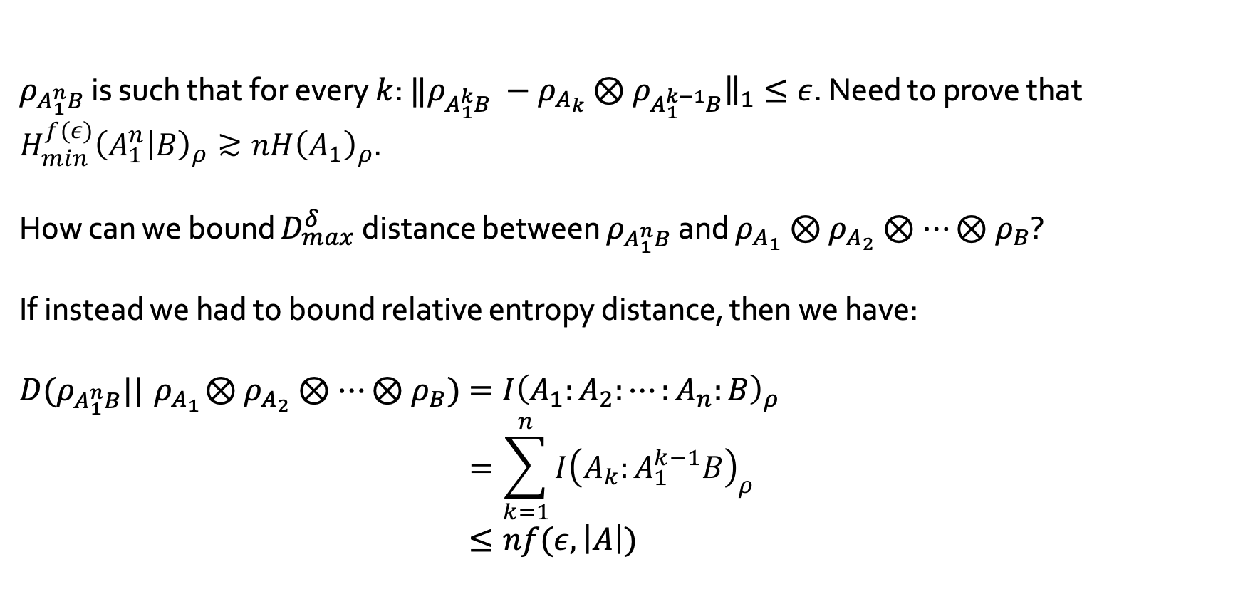
Approximate independence
$ρ_{A_{1}^{n}B}$ is such that for every $k$: $‖ρ_{A_{1}^{k}B} −{ρ_{A_{k}}⊗ρ}_{A_{1}^{k−1}B}{\left.​\right\|}_{1}≤ε$. Need to prove that $H_{min}^{f(ε)}{\left(A_{1}^{n} | B\right)}_{ρ}≳nH{\left(A_{1}\right)}_{ρ}.$
How can we bound $D_{max}^{δ}$ distance between $ρ_{A_{1}^{n}B}$ and $ρ_{A_{1}}⊗$ $ρ_{A_{2}}⊗⋯{⊗ρ}_{B}$?
If instead we had to bound relative entropy distance, then we have:
$$D(ρ_{A_{1}^{n}B}||{ ρ}_{A_{1}}⊗ρ_{A_{2}}⊗⋯{⊗ρ}_{B})=I{\left(A_{1}:A_{2}:⋯:A_{n}:B\right)}_{ρ} \\ =\sum_{k=1}^{n}{I{\left(A_{k}:A_{1}^{k−1}B\right)}_{ρ}} \\ ≤nf(ε, \left|A\right|)$$

Slide 19
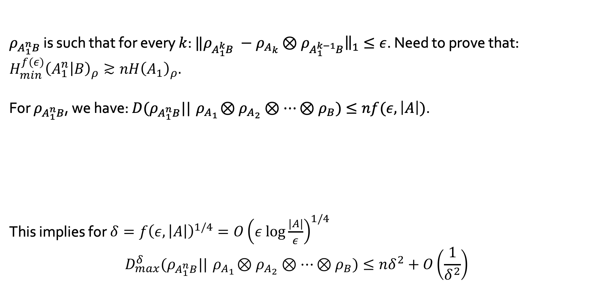

Approximate independence
$ρ_{A_{1}^{n}B}$ is such that for every $k$: $‖ρ_{A_{1}^{k}B} −{ρ_{A_{k}}⊗ρ}_{A_{1}^{k−1}B}{\left.​\right\|}_{1}≤ε$. Need to prove that: $H_{min}^{f(ε)}{\left(A_{1}^{n} | B\right)}_{ρ}≳nH{\left(A_{1}\right)}_{ρ}.$
For $ρ_{A_{1}^{n}B}$, we have: $D(ρ_{A_{1}^{n}B}||{ ρ}_{A_{1}}⊗ρ_{A_{2}}⊗⋯{⊗ρ}_{B})≤nf(ε, \left|A\right|)$.
This implies for $δ=f{\left(ε, \left|A\right|\right)}^{1/4}=O{\left(ε \text{log}\frac{\left|A\right|}{ε}\right)}^{1/4}$
$$D_{max}^{δ}(ρ_{A_{1}^{n}B}||{ ρ}_{A_{1}}⊗ρ_{A_{2}}⊗⋯{⊗ρ}_{B})≤nδ^{2}+O\left(\frac{1}{δ^{2}}\right)$$
Substate theorem [JRS02]: For two state $ρ$ and $σ$ and $δ∈(0,1)$, we have
$$D_{max}^{δ}(ρ|\left|σ\right)≤ \frac{D(ρ|\left|σ\right)+1}{δ^{2}}+\left[\text{small} \text{term}\right].$$

Slide 20
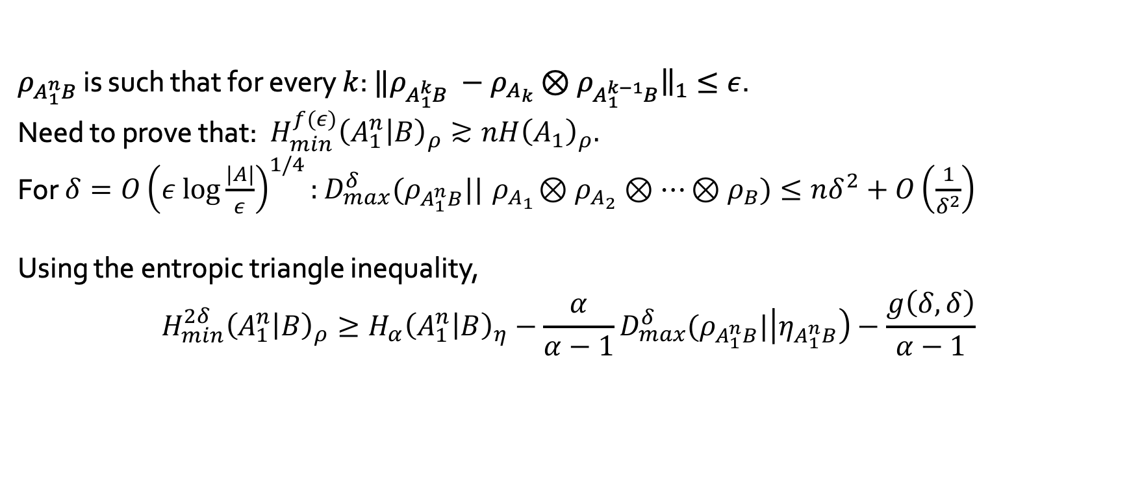
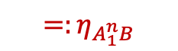
Approximate independence
$ρ_{A_{1}^{n}B}$ is such that for every $k$: $‖ρ_{A_{1}^{k}B} −{ρ_{A_{k}}⊗ρ}_{A_{1}^{k−1}B}{\left.​\right\|}_{1}≤ε$.
Need to prove that: $H_{min}^{f(ε)}{\left(A_{1}^{n} | B\right)}_{ρ}≳nH{\left(A_{1}\right)}_{ρ}.$
For $δ=O{\left(ε \text{log}\frac{\left|A\right|}{ε}\right)}^{1/4}:$ $D_{max}^{δ}(ρ_{A_{1}^{n}B}||{ ρ}_{A_{1}}⊗ρ_{A_{2}}⊗⋯{⊗ρ}_{B})≤nδ^{2}+O\left(\frac{1}{δ^{2}}\right)$
Using the entropic triangle inequality,
$$H_{min}^{2δ}{\left(A_{1}^{n} | B\right)}_{ρ}≥H_{α}{\left(A_{1}^{n} | B\right)}_{η}−{\frac{α}{α−1}D}_{max}^{δ}(ρ_{A_{1}^{n}B}|\left|η_{A_{1}^{n}B}\right)−\frac{g\left(δ,δ\right)}{α−1} \\ ≥nH_{α}{\left(A_{1} | B\right)}_{ρ} −\frac{α}{α−1 }nδ^{2} − \frac{1}{α−1}O\left(\frac{1}{δ^{2}}\right) \\ ≥n\left(H{\left(A_{1} | B\right)}_{ρ}−2nδ\right)− O\left(\frac{1}{δ^{3}}\right)$$
$${=:η}_{A_{1}^{n}B}$$

Slide 21
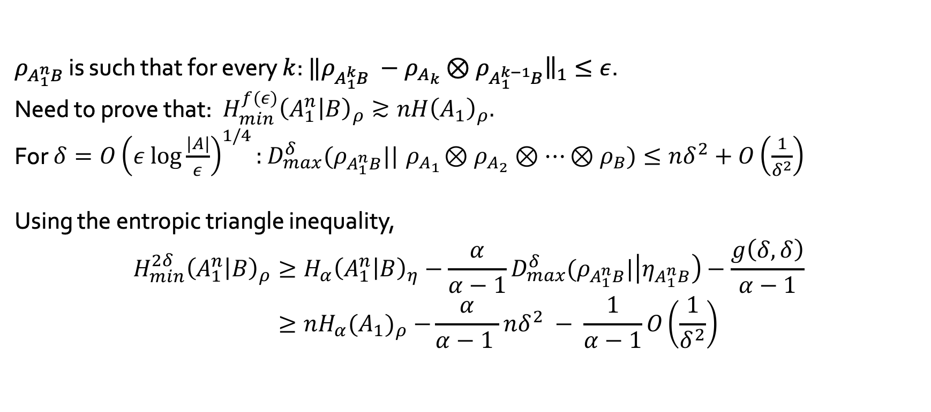
Approximate independence
$ρ_{A_{1}^{n}B}$ is such that for every $k$: $‖ρ_{A_{1}^{k}B} −{ρ_{A_{k}}⊗ρ}_{A_{1}^{k−1}B}{\left.​\right\|}_{1}≤ε$.
Need to prove that: $H_{min}^{f(ε)}{\left(A_{1}^{n} | B\right)}_{ρ}≳nH{\left(A_{1}\right)}_{ρ}.$
For $δ=O{\left(ε \text{log}\frac{\left|A\right|}{ε}\right)}^{1/4}:$ $D_{max}^{δ}(ρ_{A_{1}^{n}B}||{ ρ}_{A_{1}}⊗ρ_{A_{2}}⊗⋯{⊗ρ}_{B})≤nδ^{2}+O\left(\frac{1}{δ^{2}}\right)$
Using the entropic triangle inequality,
$$H_{min}^{2δ}{\left(A_{1}^{n} | B\right)}_{ρ}≥H_{α}{\left(A_{1}^{n} | B\right)}_{η}−{\frac{α}{α−1}D}_{max}^{δ}(ρ_{A_{1}^{n}B}|\left|η_{A_{1}^{n}B}\right)−\frac{g\left(δ,δ\right)}{α−1} \\ ≥nH_{α}{(A_{1})}_{ρ} −\frac{α}{α−1 }nδ^{2} − \frac{1}{α−1}O\left(\frac{1}{δ^{2}}\right) \\ ≥n\left(H{\left(A_{1} | B\right)}_{ρ}−2nδ\right)− O\left(\frac{1}{δ^{3}}\right)$$
$${=:η}_{A_{1}^{n}B}$$

Slide 22
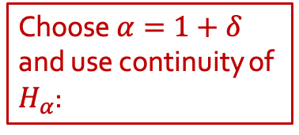
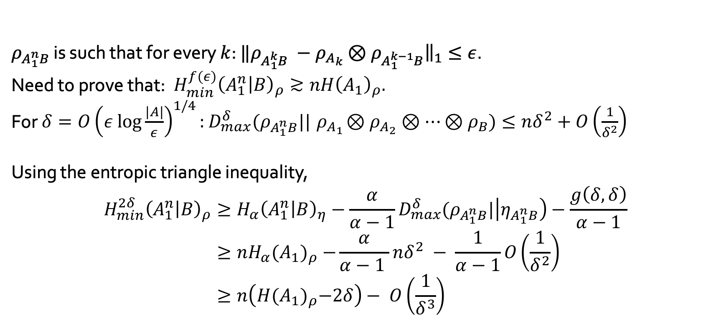
Approximate independence
$ρ_{A_{1}^{n}B}$ is such that for every $k$: $‖ρ_{A_{1}^{k}B} −{ρ_{A_{k}}⊗ρ}_{A_{1}^{k−1}B}{\left.​\right\|}_{1}≤ε$.
Need to prove that: $H_{min}^{f(ε)}{\left(A_{1}^{n} | B\right)}_{ρ}≳nH{\left(A_{1}\right)}_{ρ}.$
For $δ=O{\left(ε \text{log}\frac{\left|A\right|}{ε}\right)}^{1/4}:$ $D_{max}^{δ}(ρ_{A_{1}^{n}B}||{ ρ}_{A_{1}}⊗ρ_{A_{2}}⊗⋯{⊗ρ}_{B})≤nδ^{2}+O\left(\frac{1}{δ^{2}}\right)$
Using the entropic triangle inequality,
$$H_{min}^{2δ}{\left(A_{1}^{n} | B\right)}_{ρ}≥H_{α}{\left(A_{1}^{n} | B\right)}_{η}−{\frac{α}{α−1}D}_{max}^{δ}(ρ_{A_{1}^{n}B}|\left|η_{A_{1}^{n}B}\right)−\frac{g\left(δ,δ\right)}{α−1} \\ ≥nH_{α}{(A_{1})}_{ρ} −\frac{α}{α−1 }nδ^{2} − \frac{1}{α−1}O\left(\frac{1}{δ^{2}}\right) \\ ≥n\left(H{(A_{1})}_{ρ}−2δ\right)− O\left(\frac{1}{δ^{3}}\right)$$
$${=:η}_{A_{1}^{n}B}$$
Choose $α=1+δ$ and use continuity of $H_{α}$:

Slide 23
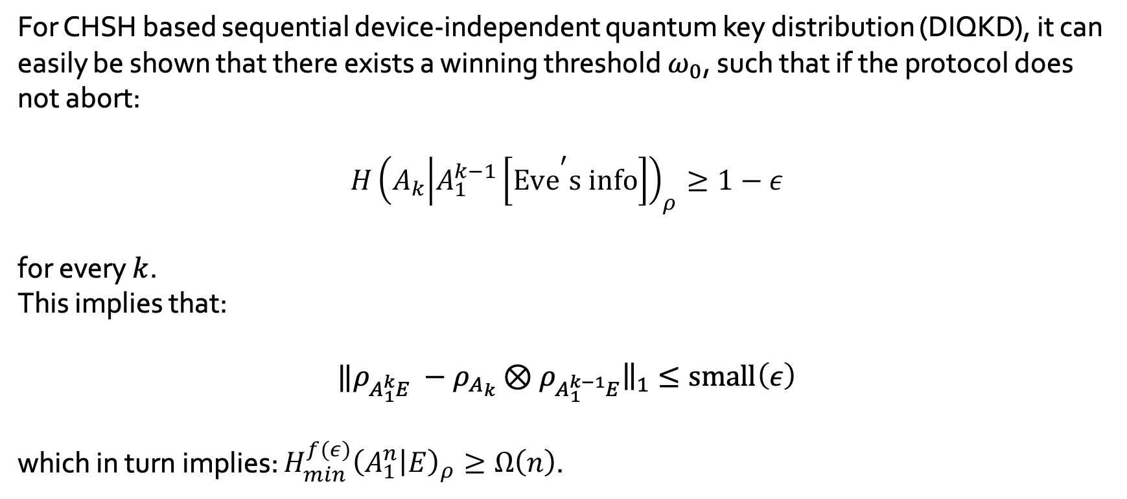

Quick and dirty proofs of security
For CHSH based sequential device-independent quantum key distribution (DIQKD), it can easily be shown that there exists a winning threshold $ω_{0}$, such that if the protocol does not abort:
$$H{\left(A_{k} | A_{1}^{k−1}\left[\text{Ev}{\text{e}}^{\text{′}}\text{s} \text{info}\right]\right)}_{ρ}≥1−ε$$
for every $k$.
This implies that:
$$‖ρ_{A_{1}^{k}E} −{ρ_{A_{k}}⊗ρ}_{A_{1}^{k−1}E}{\left.​\right\|}_{1}≤\text{small}\left(ε\right)$$
which in turn implies: $H_{min}^{f\left(ε\right)}{\left(A_{1}^{n} | E\right)}_{ρ}≥Ω\left(n\right)$.
Here $A_{k}$ is Alice’s answer in the $k$th round
Problem is that the winning threshold depends on the smoothing parameter (/security parameter).

Slide 24

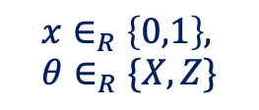

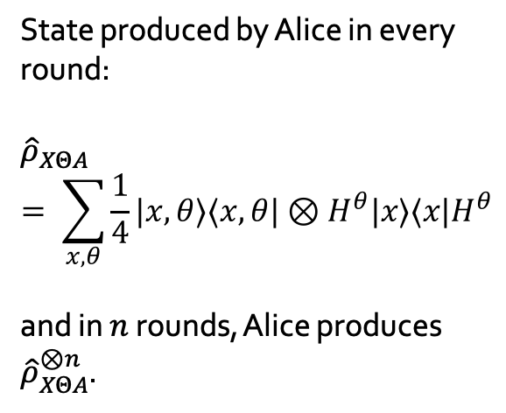

Source correlations
BB84 QKD protocol with perfect source:
In each round$:$
State produced by Alice in every round:
$${\hat{ρ}}_{XΘA}= \sum_{x, θ}{\frac{1}{4}|x,θ⟩⟨x,θ|⊗H^{θ}|x⟩⟨x|H^{θ}}$$
and in $n$ rounds, Alice produces ${\hat{ρ}}_{XΘA}^{⊗n}$.
$$x∈_{R}\left\{0,1\right\}, θ∈_{R}\{X,Z\}$$
Source
$${\left|x\right\rangle }_{θ}$$

Slide 25
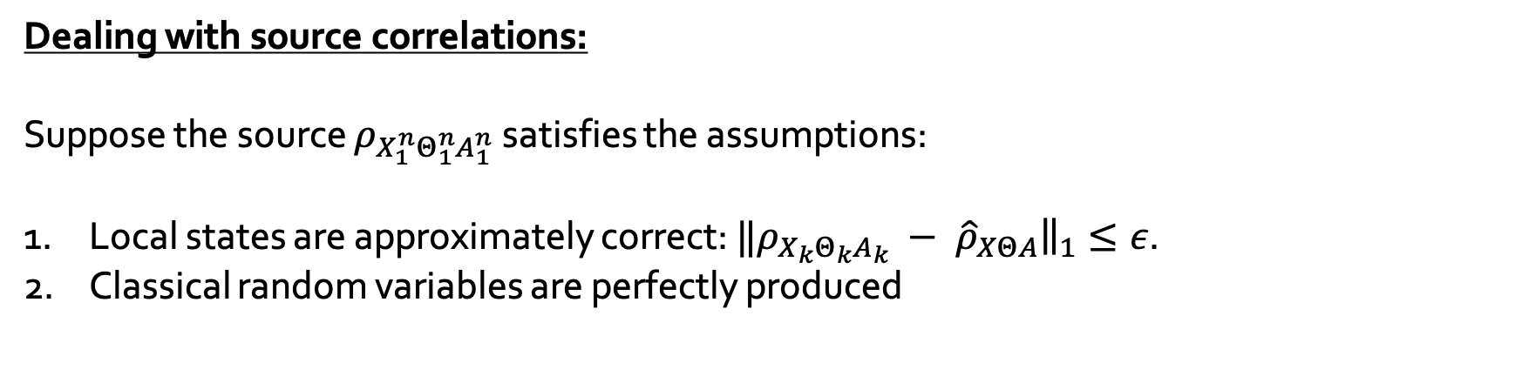
Approximate independence: applications
Dealing with source correlations:
Suppose the source $ρ_{X_{1}^{n}Θ_{1}^{n}A_{1}^{n}}$ satisfies the assumptions:
Local states are approximately correct: ${‖ρ_{X_{k}Θ_{k}A_{k}} − \hat{ρ}}_{XΘA}{\left.​\right\|}_{1}≤ε$.
Classical random variables are perfectly produced

Slide 26
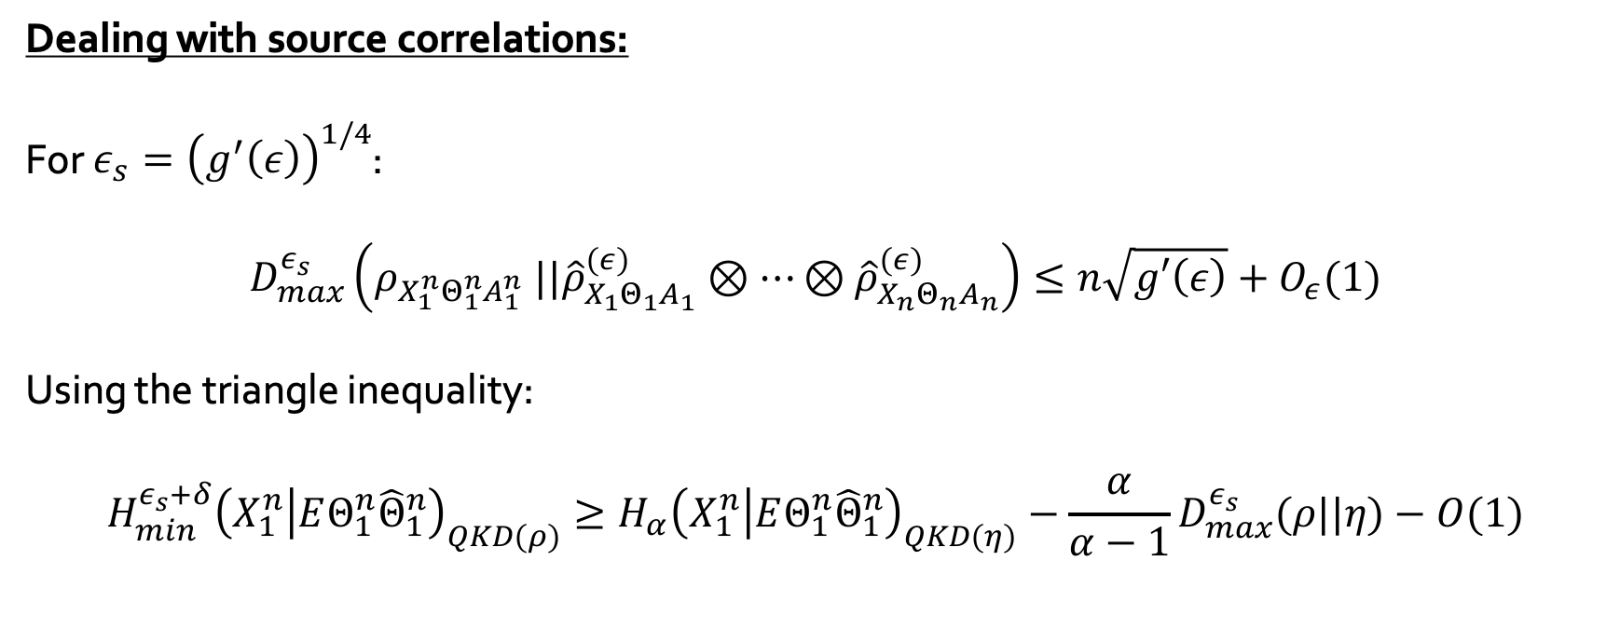

Approximate independence: applications
Dealing with source correlations:
For $ε_{s}={\left(g^{′}\left(ε\right)\right)}^{1/4}$:
$$D_{max}^{ε_{s}}\left(ρ_{X_{1}^{n}Θ_{1}^{n}A_{1}^{n}} ||{\hat{ρ}}_{X_{1}Θ_{1}A_{1}}^{\left(ε\right)}⊗⋯⊗{\hat{ρ}}_{X_{n}Θ_{n}A_{n}}^{\left(ε\right)}\right)≤n\sqrt{g′\left(ε\right)}+O_{ε}(1)$$
Using the triangle inequality:
$$H_{min}^{ε_{s}+δ}{\left(X_{1}^{n} | EΘ_{1}^{n}{\hat{Θ}}_{1}^{n}\right)}_{QKD(ρ)}≥H_{α}{\left(X_{1}^{n} | EΘ_{1}^{n}{\hat{Θ}}_{1}^{n}\right)}_{QKD\left(η\right)}−{\frac{α}{α−1}D}_{max}^{ε_{s}}(ρ||η)−O(1)$$
$$=:η$$
QKD protocol performed on the state produced by the source
QKD protocol performed on i.i.d depolarised perfect states

Slide 27

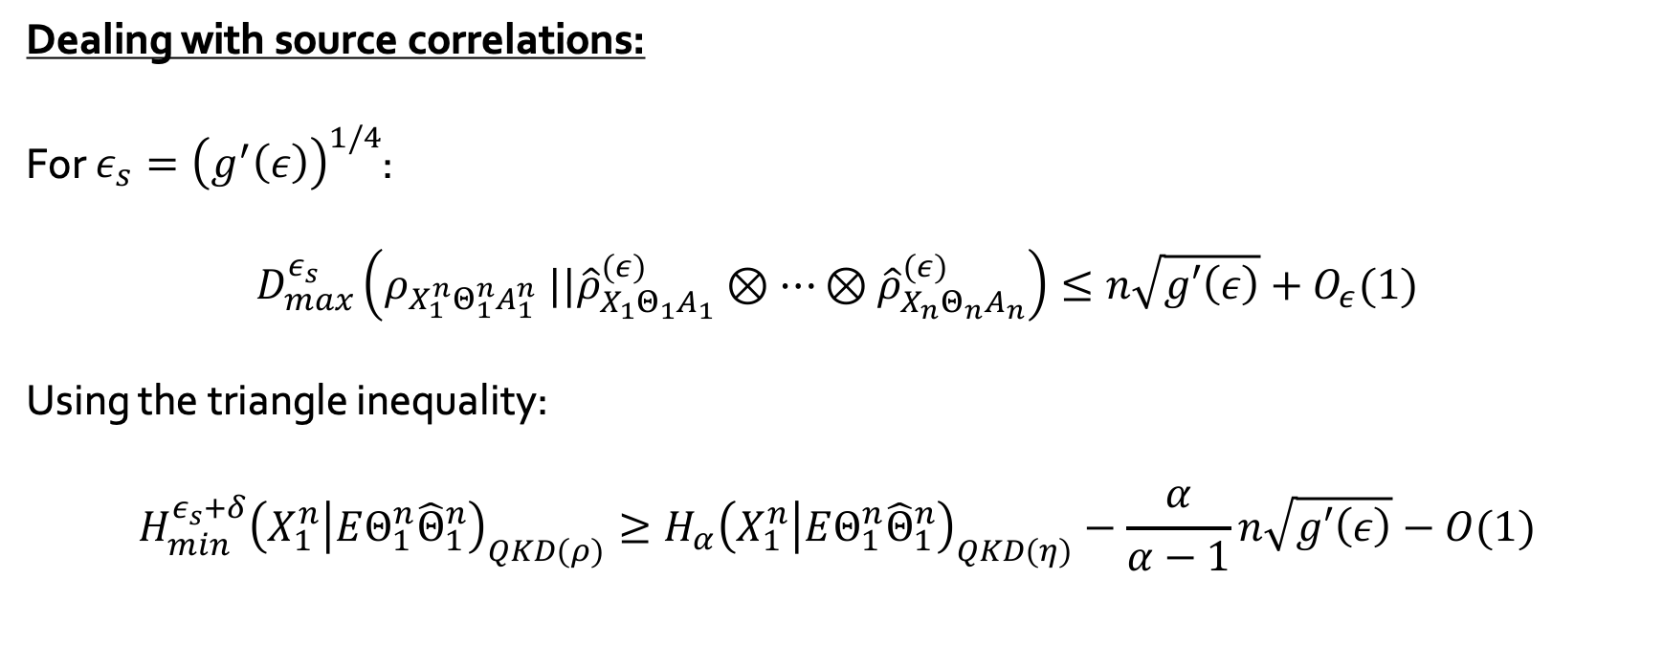
Approximate independence: applications
Problem: the security parameter is lower bounded by the noise of the source
→ Can be made arbitrarily small by instead using quantum sampling [BF10]
Dealing with source correlations:
For $ε_{s}={\left(g^{′}\left(ε\right)\right)}^{1/4}$:
$$D_{max}^{ε_{s}}\left(ρ_{X_{1}^{n}Θ_{1}^{n}A_{1}^{n}} ||{\hat{ρ}}_{X_{1}Θ_{1}A_{1}}^{\left(ε\right)}⊗⋯⊗{\hat{ρ}}_{X_{n}Θ_{n}A_{n}}^{\left(ε\right)}\right)≤n\sqrt{g′\left(ε\right)}+O_{ε}(1)$$
Using the triangle inequality:
$$H_{min}^{ε_{s}+δ}{\left(X_{1}^{n} | EΘ_{1}^{n}{\hat{Θ}}_{1}^{n}\right)}_{QKD(ρ)}≥H_{α}{\left(X_{1}^{n} | EΘ_{1}^{n}{\hat{Θ}}_{1}^{n}\right)}_{QKD\left(η\right)}−\frac{α}{α−1}n\sqrt{g′\left(ε\right)}−O(1)$$
$$=:η$$
Leads to ${\left(g^{′}\left(ε\right)\right)}^{1/4}$ entropy loss per round

Slide 28
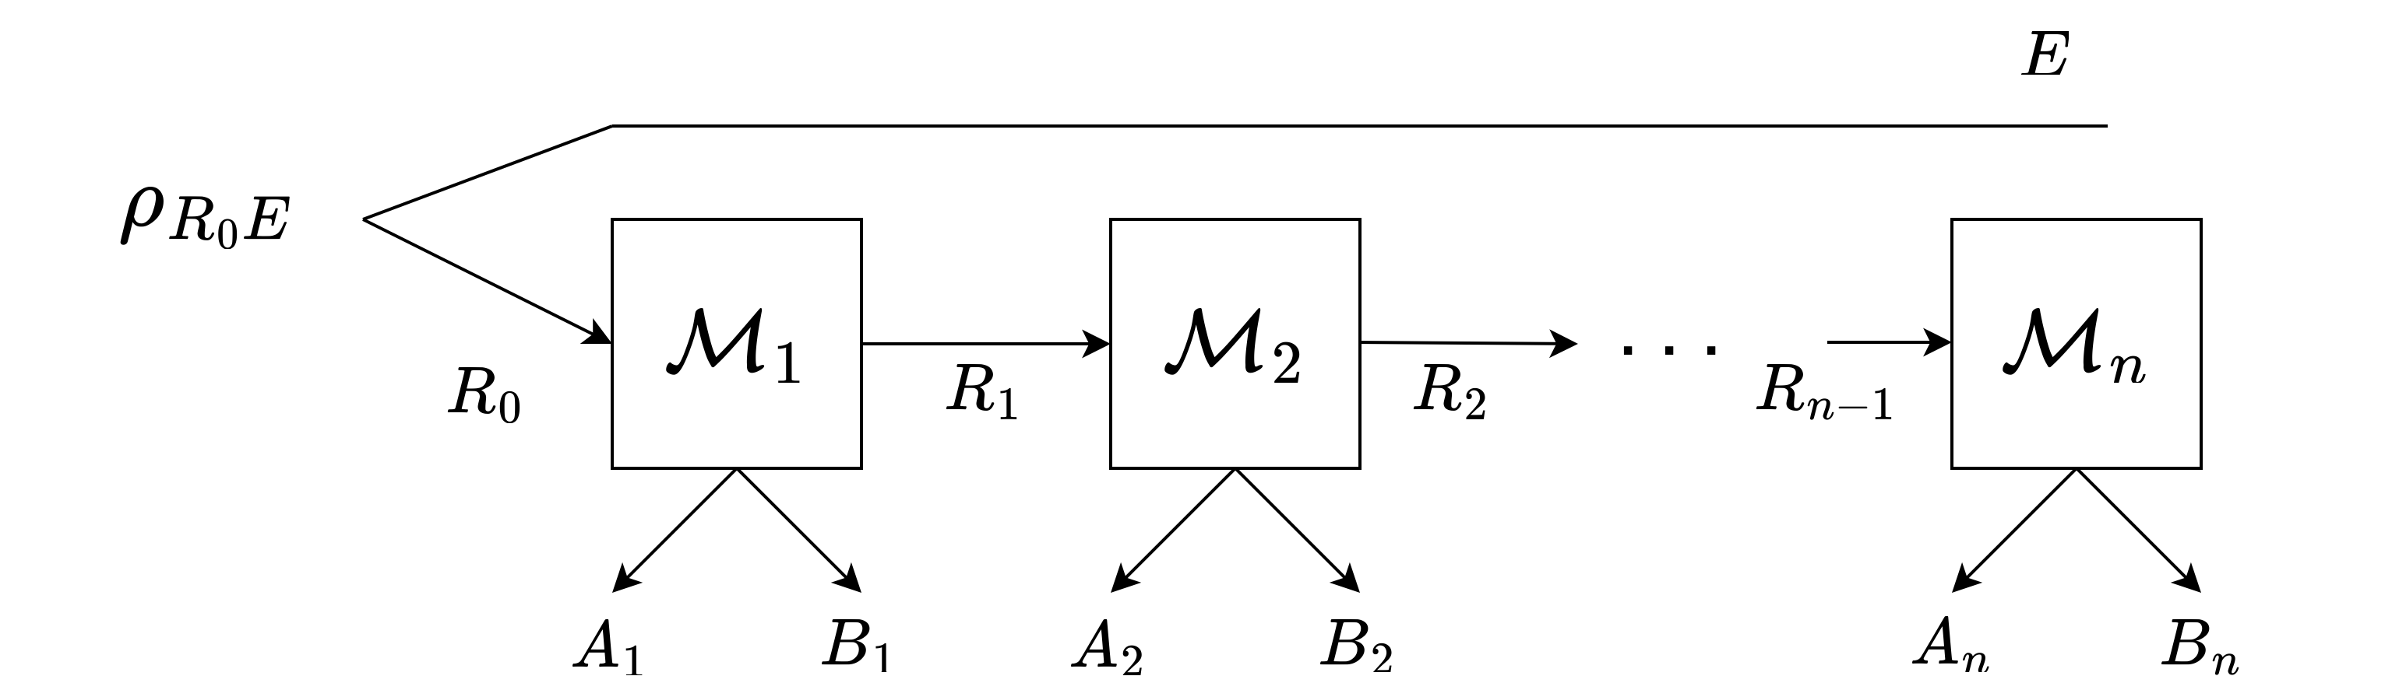
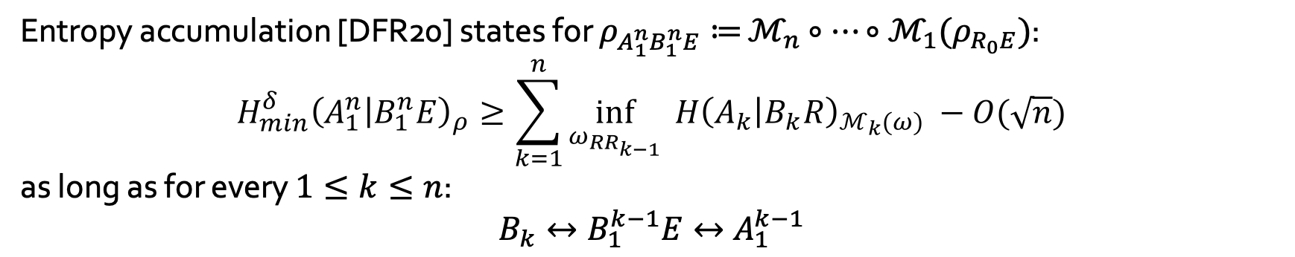
Approximate entropy accumulation
Entropy accumulation [DFR20] states for $ρ_{A_{1}^{n}B_{1}^{n}E}≔$ $ℳ_{n}∘⋯∘ℳ_{1}(ρ_{R_{0}E})$:
$$H_{min}^{δ}{\left(A_{1}^{n} | B_{1}^{n}E\right)}_{ρ}≥\sum_{k=1}^{n}{{\inf_{ω_{RR_{k−1}}}{ H\left(A_{k} | B_{k}R\right)}}_{ℳ_{k}\left(ω\right)}} −O(\sqrt{n})$$
as long as for every $1≤k≤n$:
$$B_{k}↔B_{1}^{k−1}E↔A_{1}^{k−1}$$
We wish to relax these assumptions

Slide 29
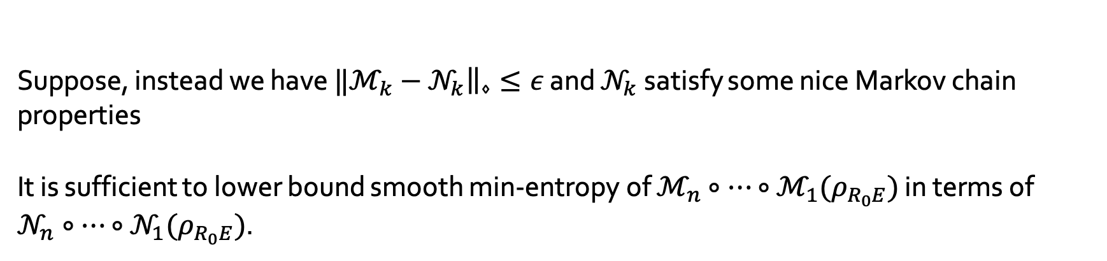
Approximate entropy accumulation
Suppose, instead we have ${‖ℳ}_{k}−𝒩_{k}{\left.​\right\|}_{⋄}≤ε$ and $𝒩_{k}$ satisfy some nice Markov chain properties
It is sufficient to lower bound smooth min-entropy of $ℳ_{n}∘⋯∘ℳ_{1}(ρ_{R_{0}E})$ in terms of $𝒩_{n}∘⋯∘𝒩_{1}(ρ_{R_{0}E})$.

Slide 30
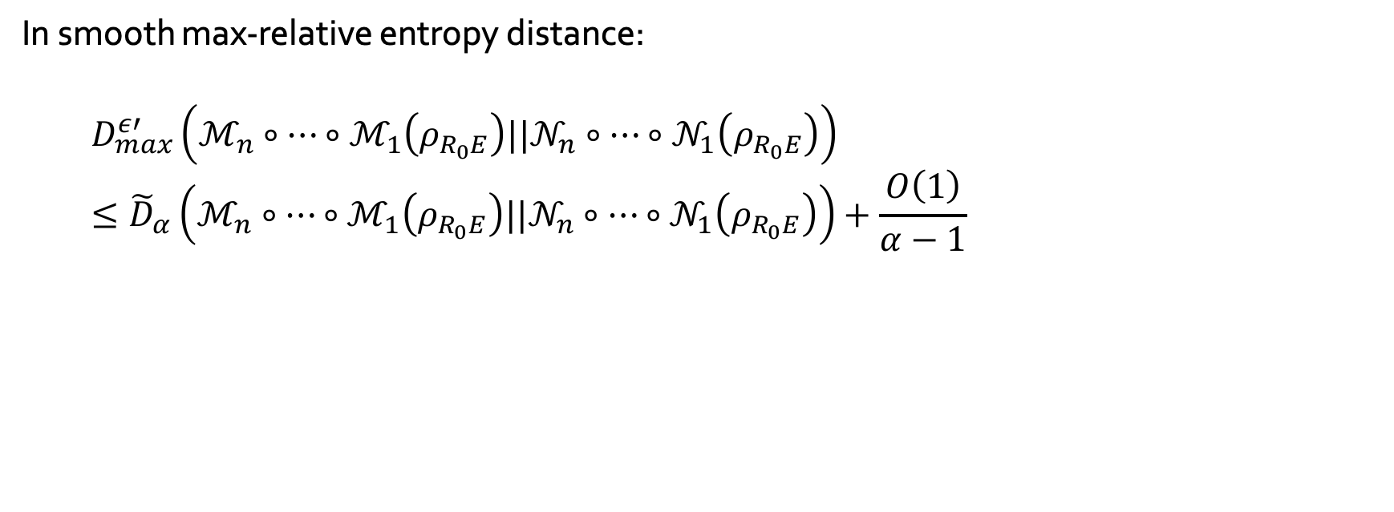
Approximate entropy accumulation
In smooth max-relative entropy distance:
$$D_{max}^{ε′}\left(ℳ_{n}∘⋯∘ℳ_{1}\left(ρ_{R_{0}E}\right)||𝒩_{n}∘⋯∘𝒩_{1}\left(ρ_{R_{0}E}\right)\right)≤{\tilde{D}}_{α}\left(ℳ_{n}∘⋯∘ℳ_{1}\left(ρ_{R_{0}E}\right)||𝒩_{n}∘⋯∘𝒩_{1}\left(ρ_{R_{0}E}\right)\right)+\frac{O\left(1\right)}{α−1} \\ ≤{\tilde{D}}_{α}\left(ℳ_{n−1}∘⋯∘ℳ_{1}\left(ρ_{R_{0}E}\right)||𝒩_{n−1}∘⋯∘𝒩_{1}\left(ρ_{R_{0}E}\right)\right)+{\tilde{D}}_{α}^{reg}(ℳ_{n}|\left|𝒩_{n}\right)+\frac{O\left(1\right)}{α−1} \\ ≤\sum_{k=1}^{n}{{\tilde{D}}_{α}^{reg}(ℳ_{k}|\left|𝒩_{k}\right)}+\frac{O\left(1\right)}{α−1}$$

Slide 31
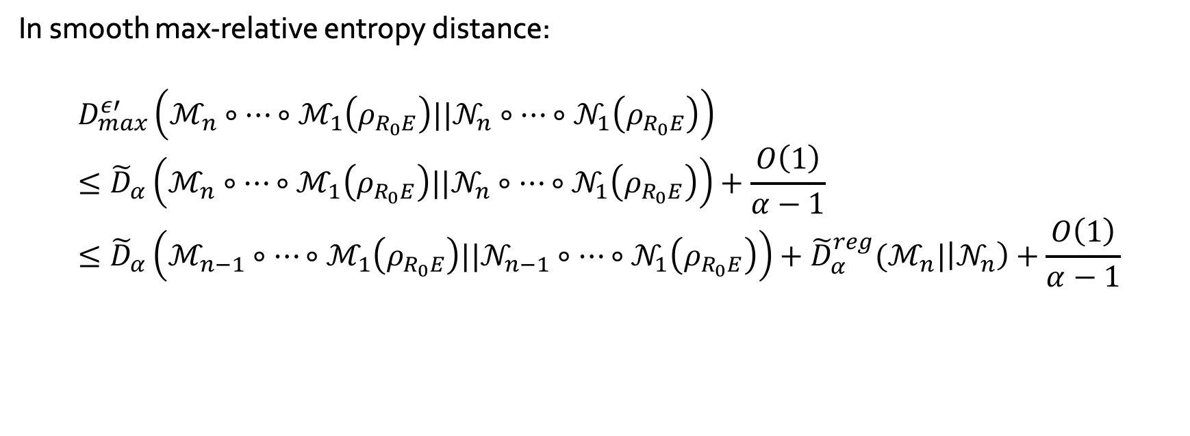
Approximate entropy accumulation
In smooth max-relative entropy distance:
$$D_{max}^{ε′}\left(ℳ_{n}∘⋯∘ℳ_{1}\left(ρ_{R_{0}E}\right)||𝒩_{n}∘⋯∘𝒩_{1}\left(ρ_{R_{0}E}\right)\right)≤{\tilde{D}}_{α}\left(ℳ_{n}∘⋯∘ℳ_{1}\left(ρ_{R_{0}E}\right)||𝒩_{n}∘⋯∘𝒩_{1}\left(ρ_{R_{0}E}\right)\right)+\frac{O\left(1\right)}{α−1} \\ ≤{\tilde{D}}_{α}\left(ℳ_{n−1}∘⋯∘ℳ_{1}\left(ρ_{R_{0}E}\right)||𝒩_{n−1}∘⋯∘𝒩_{1}\left(ρ_{R_{0}E}\right)\right)+{\tilde{D}}_{α}^{reg}(ℳ_{n}|\left|𝒩_{n}\right)+\frac{O\left(1\right)}{α−1} \\ ≤\sum_{k=1}^{n}{{\tilde{D}}_{α}^{reg}(ℳ_{k}|\left|𝒩_{k}\right)}+\frac{O\left(1\right)}{α−1}$$

Slide 32
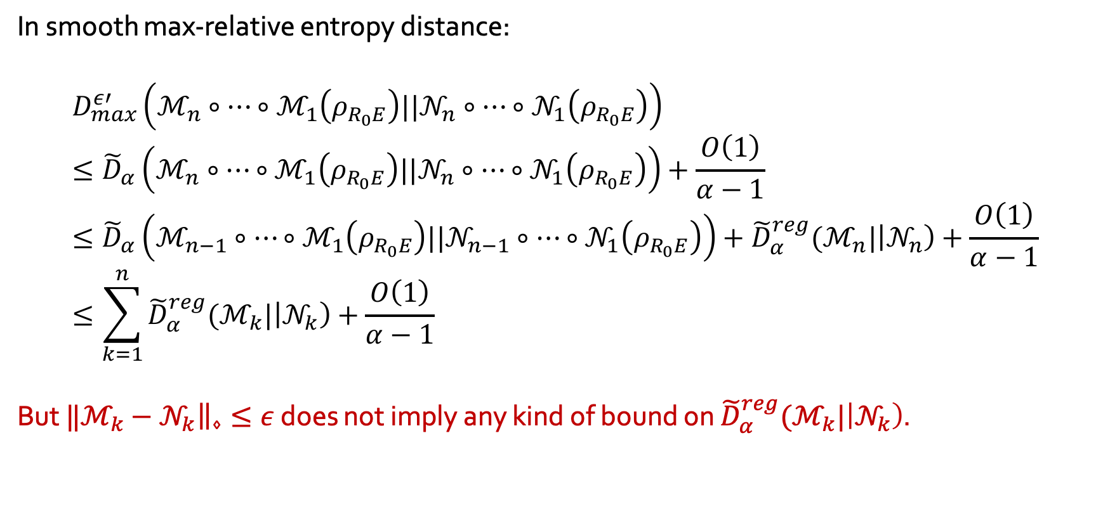
Approximate entropy accumulation
In smooth max-relative entropy distance:
$$D_{max}^{ε′}\left(ℳ_{n}∘⋯∘ℳ_{1}\left(ρ_{R_{0}E}\right)||𝒩_{n}∘⋯∘𝒩_{1}\left(ρ_{R_{0}E}\right)\right)≤{\tilde{D}}_{α}\left(ℳ_{n}∘⋯∘ℳ_{1}\left(ρ_{R_{0}E}\right)||𝒩_{n}∘⋯∘𝒩_{1}\left(ρ_{R_{0}E}\right)\right)+\frac{O\left(1\right)}{α−1} \\ ≤{\tilde{D}}_{α}\left(ℳ_{n−1}∘⋯∘ℳ_{1}\left(ρ_{R_{0}E}\right)||𝒩_{n−1}∘⋯∘𝒩_{1}\left(ρ_{R_{0}E}\right)\right)+{\tilde{D}}_{α}^{reg}(ℳ_{n}|\left|𝒩_{n}\right)+\frac{O\left(1\right)}{α−1} \\ ≤\sum_{k=1}^{n}{{\tilde{D}}_{α}^{reg}(ℳ_{k}|\left|𝒩_{k}\right)}+\frac{O\left(1\right)}{α−1}$$
But ${‖ℳ}_{k}−𝒩_{k}{\left.​\right\|}_{⋄}≤ε$ does not imply any kind of bound on ${\tilde{D}}_{α}^{reg}(ℳ_{k}|\left|𝒩_{k}\right)$.
If each of these terms were small, we would be done

Slide 33
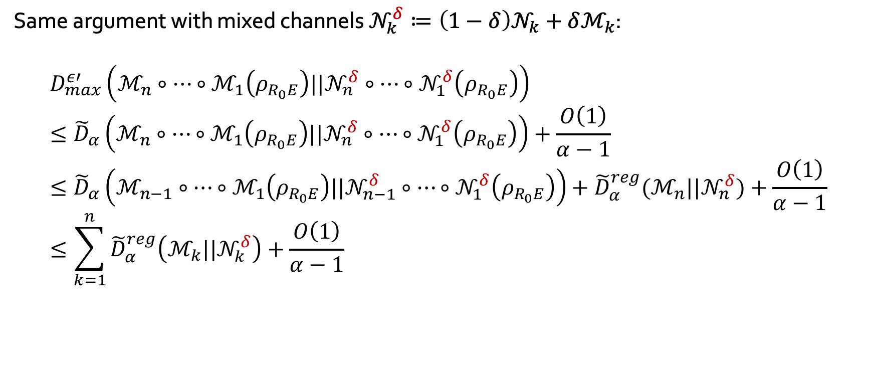
Approximate entropy accumulation
Same argument with mixed channels $𝒩_{k}^{δ}≔\left(1−δ\right)𝒩_{k}+δℳ_{k}$:
$$D_{max}^{ε′}\left(ℳ_{n}∘⋯∘ℳ_{1}\left(ρ_{R_{0}E}\right)||𝒩_{n}^{δ}∘⋯∘𝒩_{1}^{δ}\left(ρ_{R_{0}E}\right)\right)≤{\tilde{D}}_{α}\left(ℳ_{n}∘⋯∘ℳ_{1}\left(ρ_{R_{0}E}\right)||𝒩_{n}^{δ}∘⋯∘𝒩_{1}^{δ}\left(ρ_{R_{0}E}\right)\right)+\frac{O\left(1\right)}{α−1} \\ ≤{\tilde{D}}_{α}\left(ℳ_{n−1}∘⋯∘ℳ_{1}\left(ρ_{R_{0}E}\right)||𝒩_{n−1}^{δ}∘⋯∘𝒩_{1}^{δ}\left(ρ_{R_{0}E}\right)\right)+{\tilde{D}}_{α}^{reg}(ℳ_{n}{||𝒩}_{n}^{δ})+\frac{O\left(1\right)}{α−1} \\ ≤\sum_{k=1}^{n}{{\tilde{D}}_{α}^{reg}\left(ℳ_{k}{||𝒩}_{k}^{δ}\right)}+\frac{O\left(1\right)}{α−1} \\ ≤\sum_{k=1}^{n}{D_{α}^{\#}\left(ℳ_{k}{||𝒩}_{k}^{δ}\right)}+\frac{O\left(1\right)}{α−1}$$

Slide 34
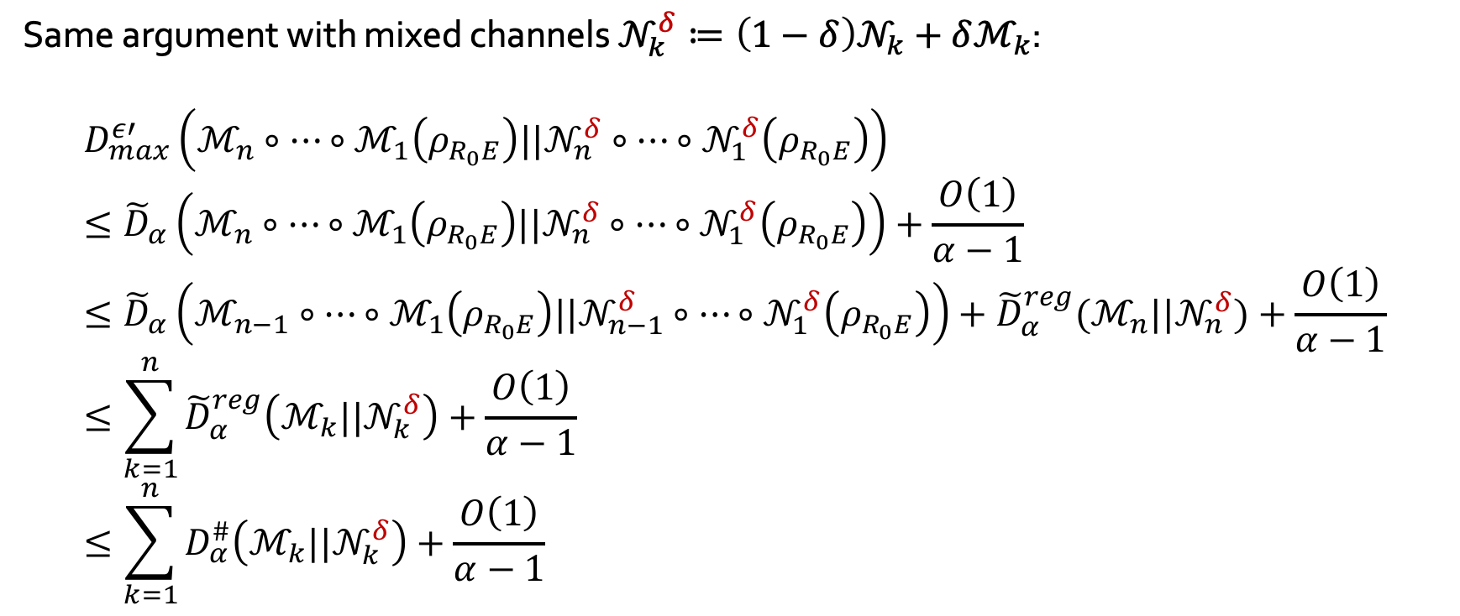
Approximate entropy accumulation
Same argument with mixed channels $𝒩_{k}^{δ}≔\left(1−δ\right)𝒩_{k}+δℳ_{k}$:
$$D_{max}^{ε′}\left(ℳ_{n}∘⋯∘ℳ_{1}\left(ρ_{R_{0}E}\right)||𝒩_{n}^{δ}∘⋯∘𝒩_{1}^{δ}\left(ρ_{R_{0}E}\right)\right)≤{\tilde{D}}_{α}\left(ℳ_{n}∘⋯∘ℳ_{1}\left(ρ_{R_{0}E}\right)||𝒩_{n}^{δ}∘⋯∘𝒩_{1}^{δ}\left(ρ_{R_{0}E}\right)\right)+\frac{O\left(1\right)}{α−1} \\ ≤{\tilde{D}}_{α}\left(ℳ_{n−1}∘⋯∘ℳ_{1}\left(ρ_{R_{0}E}\right)||𝒩_{n−1}^{δ}∘⋯∘𝒩_{1}^{δ}\left(ρ_{R_{0}E}\right)\right)+{\tilde{D}}_{α}^{reg}(ℳ_{n}{||𝒩}_{n}^{δ})+\frac{O\left(1\right)}{α−1} \\ ≤\sum_{k=1}^{n}{{\tilde{D}}_{α}^{reg}\left(ℳ_{k}{||𝒩}_{k}^{δ}\right)}+\frac{O\left(1\right)}{α−1} \\ ≤\sum_{k=1}^{n}{D_{α}^{\#}\left(ℳ_{k}{||𝒩}_{k}^{δ}\right)}+\frac{O\left(1\right)}{α−1}$$
Sharp Rényi divergence [FF21]

Slide 35
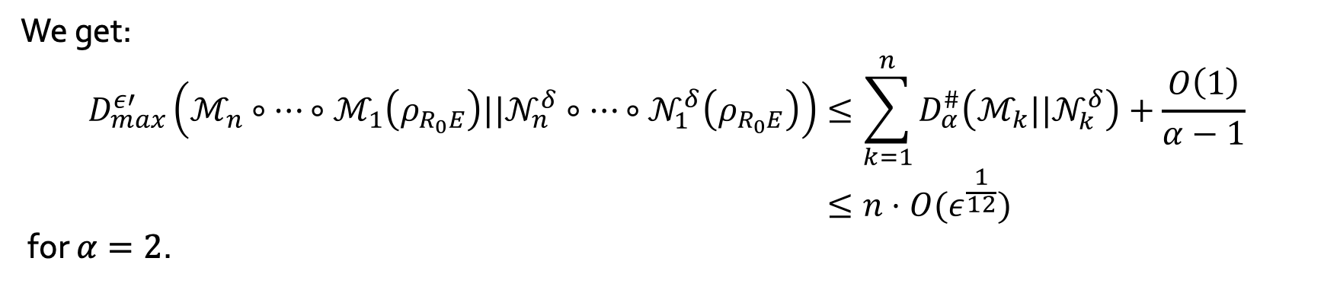
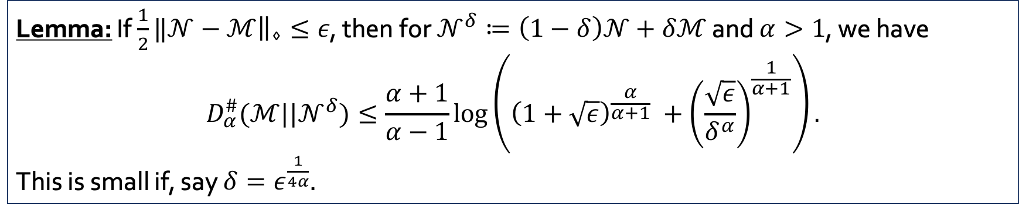
Approximate entropy accumulation
Lemma: If $\frac{1}{2}‖𝒩−{ℳ\left.​\right\|}_{⋄}≤ε$, then for $𝒩^{δ}≔\left(1−δ\right)𝒩+δℳ$ and $α>1$, we have
$$D_{α}^{\#}(ℳ||𝒩^{δ})≤\frac{α+1}{α−1}\log\left({\left(1+\sqrt{ε}\right)}^{\frac{α}{α+1}} +{\left(\frac{\sqrt{ε}}{δ^{α}}\right)}^{\frac{1}{α+1}}\right).$$
This is small if, say $δ=ε^{\frac{1}{4α}}$.
We get:
$$D_{max}^{ε′}\left(ℳ_{n}∘⋯∘ℳ_{1}\left(ρ_{R_{0}E}\right)||𝒩_{n}^{δ}∘⋯∘𝒩_{1}^{δ}\left(ρ_{R_{0}E}\right)\right)≤\sum_{k=1}^{n}{D_{α}^{\#}\left(ℳ_{k}{||𝒩}_{k}^{δ}\right)}+\frac{O\left(1\right)}{α−1} \\ ≤n⋅O(ε^{\frac{1}{12}})$$
for $α=2$.

Slide 36
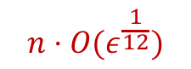

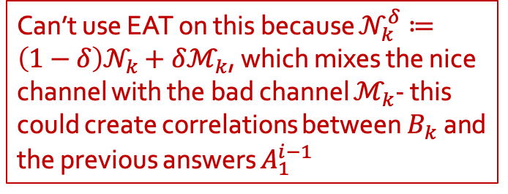
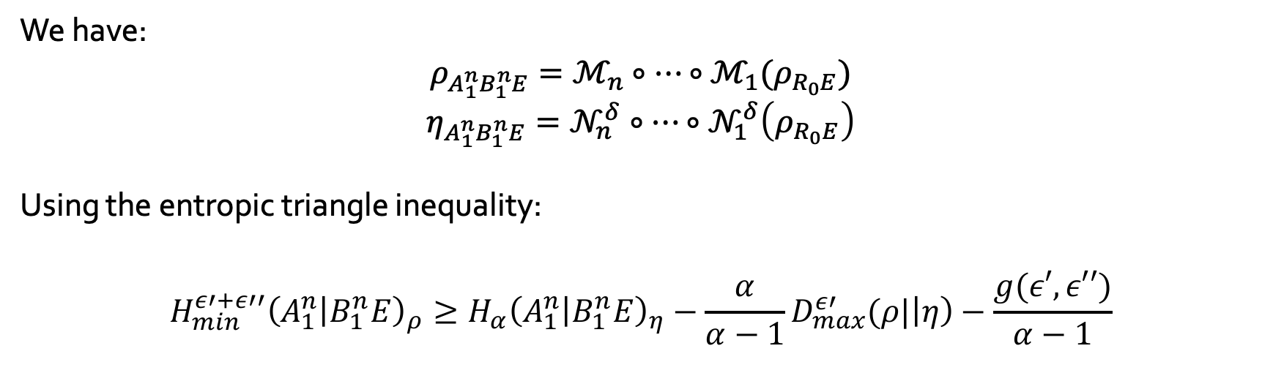
Approximate entropy accumulation
We have:
$$ρ_{A_{1}^{n}B_{1}^{n}E}=ℳ_{n}∘⋯∘ℳ_{1}(ρ_{R_{0}E})$$
$$η_{A_{1}^{n}B_{1}^{n}E}=𝒩_{n}^{δ}∘⋯∘𝒩_{1}^{δ}\left(ρ_{R_{0}E}\right)$$
Using the entropic triangle inequality:
$$H_{min}^{ε′+ε′′}{\left(A_{1}^{n} | B_{1}^{n}E\right)}_{ρ}≥H_{α}{\left(A_{1}^{n} | B_{1}^{n}E\right)}_{η}−{\frac{α}{α−1}D}_{max}^{ε′}(ρ|\left|η\right)−\frac{g(ε′,ε′′)}{α−1}$$
Can’t use EAT on this because $𝒩_{k}^{δ}≔\left(1−δ\right)𝒩_{k}+δℳ_{k}$, which mixes the nice channel with the bad channel $ℳ_{k}$- this could create correlations between $B_{k}$ and the previous answers $A_{1}^{i−1}$
$$n⋅O(ε^{\frac{1}{12}})$$
$$✅$$

Slide 37
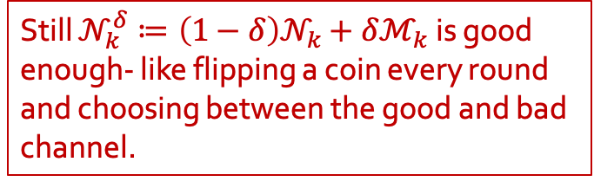

Approximate entropy accumulation
We have:
$$ρ_{A_{1}^{n}B_{1}^{n}E}=ℳ_{n}∘⋯∘ℳ_{1}(ρ_{R_{0}E})$$
$$η_{A_{1}^{n}B_{1}^{n}E}=𝒩_{n}^{δ}∘⋯∘𝒩_{1}^{δ}\left(ρ_{R_{0}E}\right)$$
Using the entropic triangle inequality:
$$H_{min}^{ε′+ε′′}{\left(A_{1}^{n} | B_{1}^{n}E\right)}_{ρ}≥H_{α}{\left(A_{1}^{n} | B_{1}^{n}E\right)}_{η}−{\frac{α}{α−1}D}_{max}^{ε′}(ρ|\left|η\right)−\frac{g(ε′,ε′′)}{α−1}$$
Still $𝒩_{k}^{δ}≔\left(1−δ\right)𝒩_{k}+δℳ_{k}$ is good enough- like flipping a coin every round and choosing between the good and bad channel.
$$n⋅O(ε^{\frac{1}{12}})$$
$$✅$$
$$✅$$

Slide 38
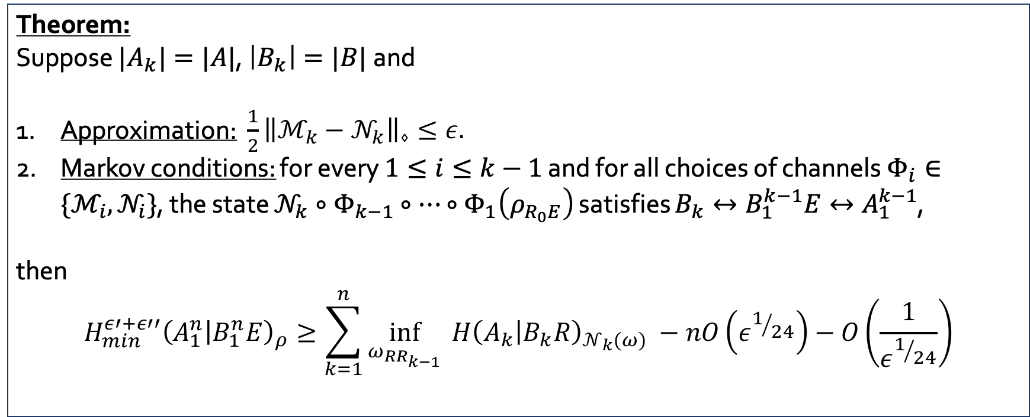
Approximate entropy accumulation
Theorem:
Suppose ${|A}_{k}|=|A|$, $\left|B_{k}\right|=|B|$ and
Approximation: $\frac{1}{2}{\left\|ℳ_{k}−𝒩_{k}\right\|}_{⋄}≤ε.$
Markov conditions: for every $1≤i≤k−1$ and for all choices of channels $Φ_{i}∈\{{ℳ_{i}, 𝒩}_{i}\}$, the state $𝒩_{k}∘Φ_{k−1}∘⋯∘Φ_{1}\left(ρ_{R_{0}E}\right)$ satisfies $B_{k}↔B_{1}^{k−1}E↔A_{1}^{k−1}$,
then
$$H_{min}^{ε′+ε′′}{\left(A_{1}^{n} | B_{1}^{n}E\right)}_{ρ}≥\sum_{k=1}^{n}{{\inf_{ω_{RR_{k−1}}}{ H\left(A_{k} | B_{k}R\right)}}_{𝒩_{k}\left(ω\right)}} −nO\left(ε^{1/{24}}\right)−O\left(\frac{1}{ε^{1/{24}}}\right)$$
Need the size of the side information to be bounded- is necessary
Entropy loss per round is poor due to bad bound for channel divergence
Smoothing error is arbitrary

Slide 39

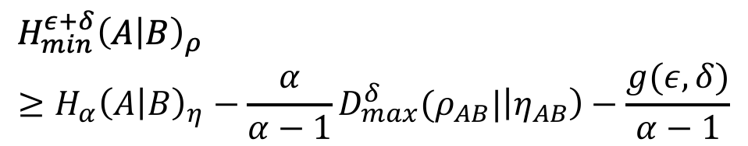
tldr; triangle inequality:
$$d\left(ρ,σ\right)≤d\left(ρ, η\right)+d(η, σ)$$
$$H_{min}^{ε+δ}{\left(A | B\right)}_{ρ}≥H_{α}{\left(A | B\right)}_{η}−{\frac{α}{α−1}D}_{max}^{δ}(ρ_{AB}|\left|η_{AB}\right)−\frac{g(ε,δ)}{α−1}$$

Slide 40
Summary
We used the entropic triangle inequality to:
create a smooth min-entropy lower bound for approximately independent registers
can also create a “weak” approximate AEP– can we do better?
provide a solution to the source correlation problem
is it practically good enough?
can we use different/ better assumptions?
better analysis?
create an approximate entropy accumulation theorem
improve the channel divergence bounds/ rate loss
can we relax assumptions further?

Slide 41
Thank you.

Slide 42
Extra slides

Slide 43
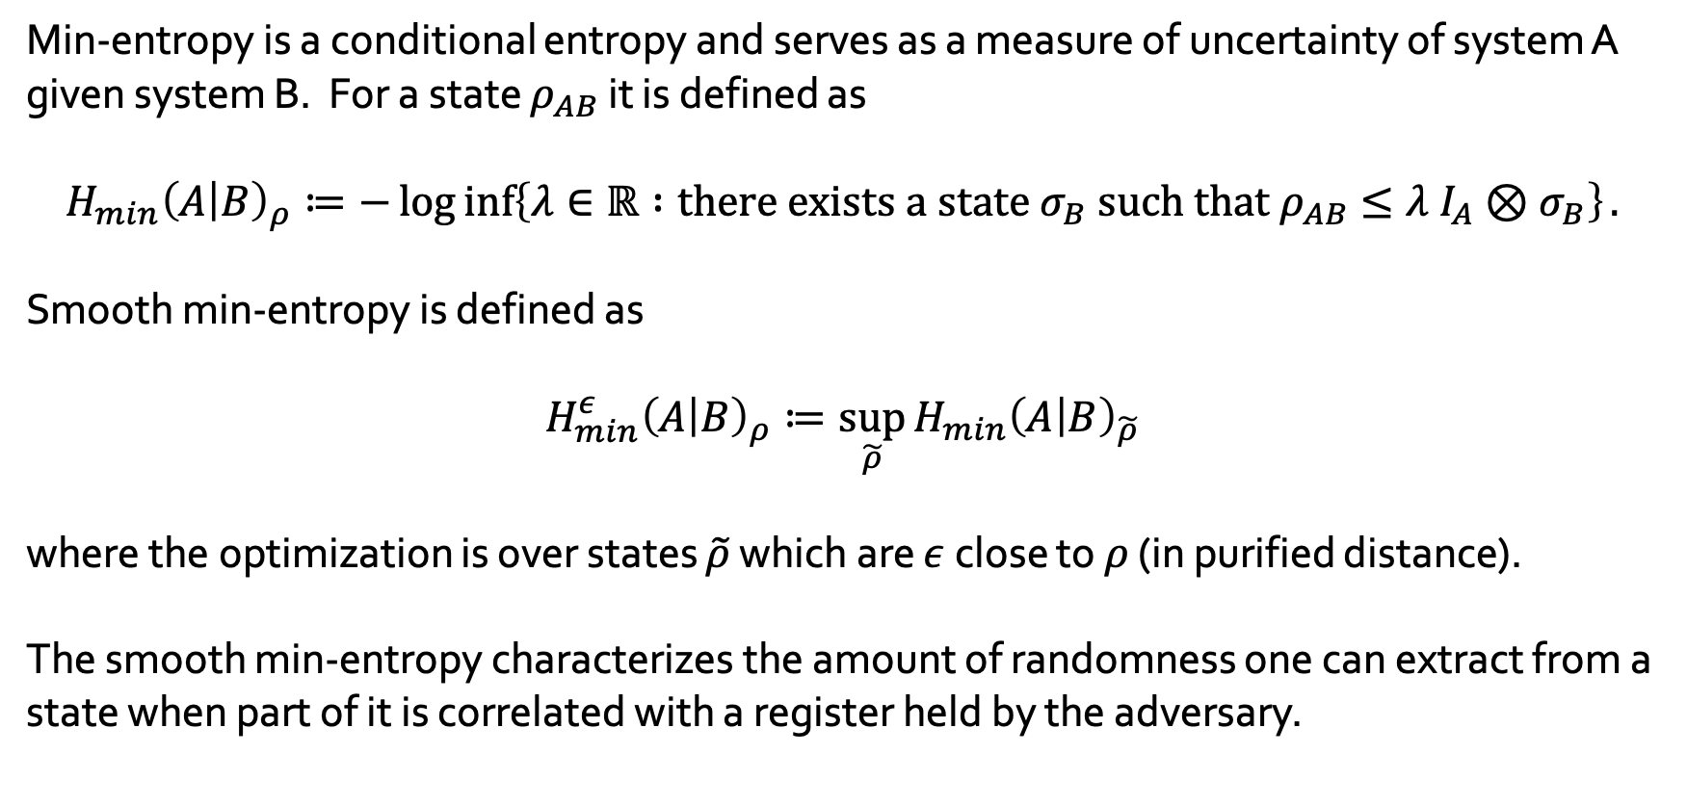
Smooth min-entropy
Min-entropy is a conditional entropy and serves as a measure of uncertainty of system A given system B. For a state $ρ_{AB}$ it is defined as
$$H_{min}{\left(A | B\right)}_{ρ}≔−\log{\inf\left\{λ∈ℝ :{\text{there} \text{exists} \text{a} \text{state} σ_{B} \text{such} \text{that} ρ}_{AB}≤λ I_{A}⊗σ_{B}\right\}}.$$
Smooth min-entropy is defined as
$$H_{min}^{ε}{\left(A | B\right)}_{ρ}≔\sup_{\tilde{ρ}}{H_{min}{\left(A | B\right)}_{\tilde{ρ}}}$$
where the optimization is over states $\tilde{ρ}$ which are $ε$ close to $ρ$ (in purified distance).
The smooth min-entropy characterizes the amount of randomness one can extract from a state when part of it is correlated with a register held by the adversary.

Slide 44
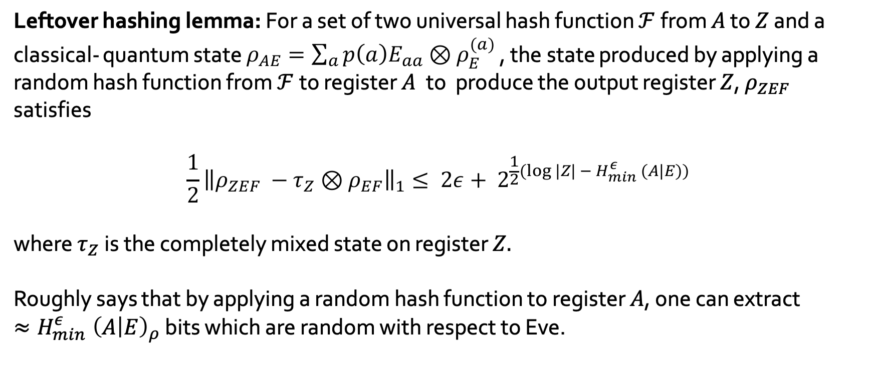
Smooth min-entropy
Leftover hashing lemma: For a set of two universal hash function $ℱ$ from $A$ to $Z$ and a classical- quantum state $ρ_{AE}=\sum_{a}{p\left(a\right)E_{aa}⊗ρ_{E}^{(a)} }$, the state produced by applying a random hash function from $ℱ$to register $A$ to produce the output register $Z$, $ρ_{ZEF}$ satisfies
$$\frac{1}{2}{\left\|ρ_{ZEF} −τ_{Z}⊗ρ_{EF}\right\|}_{1}≤ 2ε+ 2^{\frac{1}{2}(log |Z| − H_{min}^{ε} (A|E))}$$
where $τ_{Z}$is the completely mixed state on register $Z.$
Roughly says that by applying a random hash function to register $A$, one can extract ${≈H}_{min}^{ε}{\left(A | E\right)}_{ρ}$ bits which are random with respect to Eve.

Slide 45


Approximate independence: classical case
$p_{A_{1}^{n}B}$ is such that for every $k$: $‖p_{A_{1}^{k}B} −{p_{A_{k}}p}_{A_{1}^{k−1}B}{\left.​\right\|}_{1}≤ε$
This implies,
$$𝔼_{A_{1}^{k}B\sim p}\left[‖p_{{A_{k}|A}_{1}^{k−1}B} −p_{A_{k}}{\left.​\right\|}_{1}\right]≤ε$$
The conditional probability of a typical $(a_{1}^{n},b)$:
$$p\left(a_{1}^{n}|b\right)=\prod_{k=1}^{n}{p(a_{k}|a_{1}^{k−1}b)}$$
$$≤p\left(a_{k}\right)+ε$$ for most positions $k$

Slide 46

Approximate independence: classical case
$p_{A_{1}^{n}B}$ is such that for every $k$: $‖p_{A_{1}^{k}B} −{p_{A_{k}}p}_{A_{1}^{k−1}B}{\left.​\right\|}_{1}≤ε$
This implies,
$$𝔼_{A_{1}^{k}B\sim p}\left[‖p_{{A_{k}|A}_{1}^{k−1}B} −p_{A_{k}}{\left.​\right\|}_{1}\right]≤ε$$
The conditional probability of a typical $(a_{1}^{n},b)$:
$$p\left(a_{1}^{n}|b\right)≤{\left(\max_{a}{p\left(a\right)}\right)}^{n−small}$$

Slide 47

Approximate independence: classical case
$p_{A_{1}^{n}B}$ is such that for every $k$: $‖p_{A_{1}^{k}B} −{p_{A_{k}}p}_{A_{1}^{k−1}B}{\left.​\right\|}_{1}≤ε$
This implies,
$$𝔼_{A_{1}^{k}B\sim p}\left[‖p_{{A_{k}|A}_{1}^{k−1}B} −p_{A_{k}}{\left.​\right\|}_{1}\right]≤ε$$
The conditional probability of a typical $(a_{1}^{n},b)$:
$$p\left(a_{1}^{n}|b\right)≾{\left(\max_{a}{p\left(a\right)}\right)}^{n−2nε^{1/4}}$$

Slide 48


Approximate independence: classical case
The distribution $p_{A_{1}^{n}B}$ is such that for every $k$: $‖p_{A_{1}^{k}B} −{p_{A_{k}}⊗p}_{A_{1}^{k−1}B}{\left.​\right\|}_{1}≤ε$.
Lemma: Suppose $p_{X}$ and $q_{X}$ satisfy $‖p_{X} −q_{X}{\left.​\right\|}_{1}≤ε$, then $𝒢≔\left\{x∈𝒳: \frac{p\left(x\right)}{q\left(x\right)}≤1+\sqrt{ε}\right\}$ satisfies:
$$p\left(𝒢\right)≥1−2\sqrt{ε}.$$
Proof: Use the Markov inequality with the random variable $Z(X)≔\left|\frac{p\left(X\right)}{q\left(X\right)}−1\right|$ for $X∼q(X)$.

Slide 49

Approximate independence: classical case
The distribution $p_{A_{1}^{n}B}$ is such that for every $k$: $‖p_{A_{1}^{k}B} −{p_{A_{k}}⊗p}_{A_{1}^{k−1}B}{\left.​\right\|}_{1}≤ε$.
Define “bad” sets:
$$B_{k}≔\left\{\left(a_{1}^{n},b\right) : p\left(a_{1}^{k},b\right)>\left(1+\sqrt{ε}\right)p\left(a_{k}\right)p\left(a_{1}^{k−1}b\right)\right\}$$
Lemma: $‖p_{X} −q_{X}{\left.​\right\|}_{1}≤ε⇒$ $𝒢≔\left\{x∈𝒳: \frac{p\left(x\right)}{q\left(x\right)}≤1+\sqrt{ε}\right\}$ satisfies $p\left(𝒢\right)≥1−2\sqrt{ε}.$

Slide 50

Approximate independence: classical case
The distribution $p_{A_{1}^{n}B}$ is such that for every $k$: $‖p_{A_{1}^{k}B} −{p_{A_{k}}⊗p}_{A_{1}^{k−1}B}{\left.​\right\|}_{1}≤ε$.
Define “bad” sets:
$$B_{k}≔\left\{\left(a_{1}^{n},b\right) : p\left(a_{1}^{k},b\right)>\left(1+\sqrt{ε}\right)p\left(a_{k}\right)p\left(a_{1}^{k−1}b\right)\right\} \\ ≔\left\{\left(a_{1}^{n},b\right) : p\left({a_{k}|a}_{1}^{k−1},b\right)>\left(1+\sqrt{ε}\right)p\left(a_{k}\right)\right\}.$$
By Lemma above: ${p(B}_{k})≤2\sqrt{ε}$.
Lemma: $‖p_{X} −q_{X}{\left.​\right\|}_{1}≤ε⇒$ $𝒢≔\left\{x∈𝒳: \frac{p\left(x\right)}{q\left(x\right)}≤1+\sqrt{ε}\right\}$ satisfies $p\left(𝒢\right)≥1−2\sqrt{ε}.$

Slide 51

Approximate independence: classical case
The distribution $p_{A_{1}^{n}B}$ is such that for every $k$: $‖p_{A_{1}^{k}B} −{p_{A_{k}}⊗p}_{A_{1}^{k−1}B}{\left.​\right\|}_{1}≤ε$.
Define $\text{BadCnt}\left(a_{1}^{n},b\right)=\#\{k :\left(a_{1}^{n},b\right)∈B_{k}\}$.
Actually,
$$\text{BadCnt}=\sum_{k=1}^{n}{χ_{B_{k}}}.$$
In particular, $E(\text{BadCnt}\text{)}≤2n\sqrt{ε}$.
Useful stuff: $B_{k}≔\left\{\left(a_{1}^{n},b\right):p\left(a_{1}^{k},b\right)>\left(1+\sqrt{ε}\right)p\left(a_{k}\right)p\left(a_{1}^{k−1}b\right)\right\}$ and ${p(B}_{k})≤2\sqrt{ε}$.

Slide 52


Approximate independence: classical case
The distribution $p_{A_{1}^{n}B}$ is such that for every $k$: $‖p_{A_{1}^{k}B} −{p_{A_{k}}⊗p}_{A_{1}^{k−1}B}{\left.​\right\|}_{1}≤ε$.
Using Markov inequality,
$$p\left(\text{BadCnt}>2nε^{1/4}\right)≤ε^{1/4}$$
Define the set $S≔\left\{\left(a_{1}^{n},b\right):\text{BadCnt}\left(a_{1}^{n},b\right)≤2nε^{1/4}\right\}$, so $p\left(S\right)≥1−ε^{1/4}$.
Useful stuff: $B_{k}≔\left\{\left(a_{1}^{n},b\right):p\left(a_{1}^{k},b\right)>\left(1+\sqrt{ε}\right)p\left(a_{k}\right)p\left(a_{1}^{k−1}b\right)\right\}$
$\text{BadCnt}\left(a_{1}^{n},b\right)=\#\{k :\left(a_{1}^{n},b\right)∈B_{k}\}$ and $E(\text{BadCnt}\text{)}≤2n\sqrt{ε}$.

Slide 53



Approximate independence: classical case
The distribution $p_{A_{1}^{n}B}$ is such that for every $k$: $‖p_{A_{1}^{k}B} −{p_{A_{k}}⊗p}_{A_{1}^{k−1}B}{\left.​\right\|}_{1}≤ε$.
For every $\left(a_{1}^{n},b\right)∈S$, we have
Useful stuff: $B_{k}≔\left\{\left(a_{1}^{n},b\right):p\left(a_{1}^{k},b\right)>\left(1+\sqrt{ε}\right)p\left(a_{k}\right)p\left(a_{1}^{k−1}b\right)\right\}$
$\text{BadCnt}\left(a_{1}^{n},b\right)=\#\{k :\left(a_{1}^{n},b\right)∈B_{k}\}$
$S≔\left\{\left(a_{1}^{n},b\right):\text{BadCnt}\left(a_{1}^{n},b\right)≤2nε^{1/4}\right\}$, and $p\left(S\right)≥1−ε^{1/4}$
$$p\left(a_{1}^{n}|b\right)= \prod_{k=1}^{n}{p(a_{k}|a_{1}^{k−1}b)} \\ =\prod_{k: \left(a_{1}^{n},b\right)∉B_{k}}{p(a_{k}|a_{1}^{k−1}b)}\prod_{k: \left(a_{1}^{n},b\right)∈B_{k}}{p(a_{k}|a_{1}^{k−1}b)}$$

Slide 54



Approximate independence: classical case
The distribution $p_{A_{1}^{n}B}$ is such that for every $k$: $‖p_{A_{1}^{k}B} −{p_{A_{k}}⊗p}_{A_{1}^{k−1}B}{\left.​\right\|}_{1}≤ε$.
For every $\left(a_{1}^{n},b\right)∈S$, we have
Useful stuff: $B_{k}≔\left\{\left(a_{1}^{n},b\right):p\left(a_{1}^{k},b\right)>\left(1+\sqrt{ε}\right)p\left(a_{k}\right)p\left(a_{1}^{k−1}b\right)\right\}$
$\text{BadCnt}\left(a_{1}^{n},b\right)=\#\{k :\left(a_{1}^{n},b\right)∈B_{k}\}$
$S≔\left\{\left(a_{1}^{n},b\right):\text{BadCnt}\left(a_{1}^{n},b\right)≤2nε^{1/4}\right\}$, and $p\left(S\right)≥1−ε^{1/4}$
$$p\left(a_{1}^{n}|b\right)= \prod_{k=1}^{n}{p(a_{k}|a_{1}^{k−1}b)} \\ =\prod_{k: \left(a_{1}^{n},b\right)∉B_{k}}{p(a_{k}|a_{1}^{k−1}b)}\prod_{k: \left(a_{1}^{n},b\right)∈B_{k}}{p(a_{k}|a_{1}^{k−1}b)}$$
$$≤\left(1+\sqrt{ε}\right)p(a_{k})$$
$$≤1$$

Slide 55

Approximate independence: classical case
The distribution $p_{A_{1}^{n}B}$ is such that for every $k$: $‖p_{A_{1}^{k}B} −{p_{A_{k}}⊗p}_{A_{1}^{k−1}B}{\left.​\right\|}_{1}≤ε$.
For every $\left(a_{1}^{n},b\right)∈S$, we have
$$p\left(a_{1}^{n}|b\right)= \prod_{k=1}^{n}{p(a_{k}|a_{1}^{k−1}b)} \\ ≤{\left(1+\sqrt{ε}\right)}^{n}\prod_{k: \left(a_{1}^{n},b\right)∉B_{k}}{p\left(a_{k}\right)}\prod_{\left(a_{1}^{n},b\right)∉B_{k}}{p(a_{k}|a_{1}^{k−1}b)}$$
Useful stuff: $B_{k}≔\left\{\left(a_{1}^{n},b\right):p\left(a_{1}^{k},b\right)>\left(1+\sqrt{ε}\right)p\left(a_{k}\right)p\left(a_{1}^{k−1}b\right)\right\}$
$\text{BadCnt}\left(a_{1}^{n},b\right)=\#\{k :\left(a_{1}^{n},b\right)∈B_{k}\}$
$S≔\left\{\left(a_{1}^{n},b\right):\text{BadCnt}\left(a_{1}^{n},b\right)≤2nε^{1/4}\right\}$, and $p\left(S\right)≥1−ε^{1/4}$

Slide 56

Approximate independence: classical case
The distribution $p_{A_{1}^{n}B}$ is such that for every $k$: $‖p_{A_{1}^{k}B} −{p_{A_{k}}⊗p}_{A_{1}^{k−1}B}{\left.​\right\|}_{1}≤ε$.
For every $\left(a_{1}^{n},b\right)∈S$, we have
$$p\left(a_{1}^{n}|b\right)= \prod_{k=1}^{n}{p(a_{k}|a_{1}^{k−1}b)} \\ ≤{\left(1+\sqrt{ε}\right)}^{n}\prod_{k: \left(a_{1}^{n},b\right)∉B_{k}}{\max_{a}{p(a)}}\prod_{\left(a_{1}^{n},b\right)∉B_{k}}{p(a_{k}|a_{1}^{k−1}b)}$$
Useful stuff: $B_{k}≔\left\{\left(a_{1}^{n},b\right):p\left(a_{1}^{k},b\right)>\left(1+\sqrt{ε}\right)p\left(a_{k}\right)p\left(a_{1}^{k−1}b\right)\right\}$
$\text{BadCnt}\left(a_{1}^{n},b\right)=\#\{k :\left(a_{1}^{n},b\right)∈B_{k}\}$
$S≔\left\{\left(a_{1}^{n},b\right):\text{BadCnt}\left(a_{1}^{n},b\right)≤2nε^{1/4}\right\}$, and $p\left(S\right)≥1−ε^{1/4}$

Slide 57


Approximate independence: classical case
The distribution $p_{A_{1}^{n}B}$ is such that for every $k$: $‖p_{A_{1}^{k}B} −{p_{A_{k}}⊗p}_{A_{1}^{k−1}B}{\left.​\right\|}_{1}≤ε$.
For every $\left(a_{1}^{n},b\right)∈S$, we have
$$p\left(a_{1}^{n}|b\right)= \prod_{k=1}^{n}{p(a_{k}|a_{1}^{k−1}b)} \\ ≤{\left(1+\sqrt{ε}\right)}^{n}\prod_{k: \left(a_{1}^{n},b\right)∉B_{k}}{2^{−H_{min}{\left(A\right)}_{p}}}\prod_{\left(a_{1}^{n},b\right)∉B_{k}}{p(a_{k}|a_{1}^{k−1}b)}$$
Useful stuff: $B_{k}≔\left\{\left(a_{1}^{n},b\right):p\left(a_{1}^{k},b\right)>\left(1+\sqrt{ε}\right)p\left(a_{k}\right)p\left(a_{1}^{k−1}b\right)\right\}$
$\text{BadCnt}\left(a_{1}^{n},b\right)=\#\{k :\left(a_{1}^{n},b\right)∈B_{k}\}$
$S≔\left\{\left(a_{1}^{n},b\right):\text{BadCnt}\left(a_{1}^{n},b\right)≤2nε^{1/4}\right\}$, and $p\left(S\right)≥1−ε^{1/4}$
at least $\left(1−2ε^{1/4}\right)n$ such $k$ because $\text{BadCnt}≤2nε^{1/4}$ for S

Slide 58

Approximate independence: classical case
The distribution $p_{A_{1}^{n}B}$ is such that for every $k$: $‖p_{A_{1}^{k}B} −{p_{A_{k}}⊗p}_{A_{1}^{k−1}B}{\left.​\right\|}_{1}≤ε$.
For every $\left(a_{1}^{n},b\right)∈S$, we have
$$p\left(a_{1}^{n}|b\right)≤{{\left(1+\sqrt{ε}\right)}^{n}2}^{−\left(1−2ε^{1/4}\right)nH_{min}\left(A_{1}\right)}.$$
The subnormal distribution $p_{A_{1}^{n}B}^{′}≔p_{A_{1}^{n}B ∧ S}$ satisfies $‖p_{A_{1}^{n}B} −p_{A_{1}^{n}B}^{′}{\left.​\right\|}_{1}≤ε^{1/4}$. Thus,
$$H_{min}^{ε^{1/4}}{\left(A_{1}^{n} | B\right)}_{p}≥\left(1−2ε^{1/4}\right)nH_{min}\left(A_{1}\right) −n\log\left(1+\sqrt{ε}\right)$$
Useful stuff: $B_{k}≔\left\{\left(a_{1}^{n},b\right):p\left(a_{1}^{k},b\right)>\left(1+\sqrt{ε}\right)p\left(a_{k}\right)p\left(a_{1}^{k−1}b\right)\right\}$
$\text{BadCnt}\left(a_{1}^{n},b\right)=\#\{k :\left(a_{1}^{n},b\right)∈B_{k}\}$
$S≔\left\{\left(a_{1}^{n},b\right):\text{BadCnt}\left(a_{1}^{n},b\right)≤2nε^{1/4}\right\}$, and $p\left(S\right)≥1−ε^{1/4}$

Slide 59


Approximate independence: applications
Dealing with source correlations:
Suppose the source $ρ_{X_{1}^{n}Θ_{1}^{n}A_{1}^{n}}$ satisfies the assumptions:
Local states are approximately correct: ${‖ρ_{X_{k}Θ_{k}A_{k}} − \hat{ρ}}_{XΘA}{\left.​\right\|}_{1}≤ε$.
Classical random variables are perfectly produced
Then, the divergence:
$$D(ρ_{X_{1}^{n}Θ_{1}^{n}A_{1}^{n}} || {\hat{ρ}}_{X_{1}Θ_{1}A_{1}}^{\left(ε\right)}⊗⋯⊗{\hat{ρ}}_{X_{n}Θ_{n}A_{n}}^{\left(ε\right)})=D(ρ_{X_{1}^{n}Θ_{1}^{n}A_{1}^{n}} ||{ ρ}_{X_{1}Θ_{1}A_{1}}⊗⋯⊗ρ_{X_{n}Θ_{n}A_{n}})+\sum_{k=1}^{n}{D(ρ_{X_{k}Θ_{k}A_{k}}||{\hat{ρ}}_{X_{k}Θ_{k}A_{k}}^{\left(ε\right)})}$$
Perfect states with a small amount of noise ($ε$) applied to the $A$ registers

Slide 60




Approximate independence: applications
Dealing with source correlations:
Suppose the source $ρ_{X_{1}^{n}Θ_{1}^{n}A_{1}^{n}}$ satisfies the assumptions:
Local states are approximately correct: ${‖ρ_{X_{k}Θ_{k}A_{k}} − \hat{ρ}}_{XΘA}{\left.​\right\|}_{1}≤ε$.
Classical random variables are perfectly produced
Then, the divergence:
$$D(ρ_{X_{1}^{n}Θ_{1}^{n}A_{1}^{n}} || {\hat{ρ}}_{X_{1}Θ_{1}A_{1}}^{\left(ε\right)}⊗⋯⊗{\hat{ρ}}_{X_{n}Θ_{n}A_{n}}^{\left(ε\right)})=D(ρ_{X_{1}^{n}Θ_{1}^{n}A_{1}^{n}} ||{ ρ}_{X_{1}Θ_{1}A_{1}}⊗⋯⊗ρ_{X_{n}Θ_{n}A_{n}})+\sum_{k=1}^{n}{D(ρ_{X_{k}Θ_{k}A_{k}}||{\hat{ρ}}_{X_{k}Θ_{k}A_{k}}^{\left(ε\right)})}$$
Since, $ρ_{X_{k}Θ_{k}A_{k}}≈_{3ε}{\hat{ρ}}_{X_{k}Θ_{k}A_{k}}^{\left(ε\right)}$ and ${\hat{ρ}}_{X_{k}Θ_{k}A_{k}}^{\left(ε\right)}≥\frac{ε}{\left|X\right|\left|Θ\right||A|}I_{X_{k}Θ_{k}A_{k}}$
$I(X_{1}Θ_{1}A_{1}:X_{2}Θ_{2}A_{2}:⋯:X_{n}Θ_{n}A_{n}$)
$$≤O(ε)$$

Slide 61

Approximate independence: applications
Dealing with source correlations:
We have:
$$D(ρ_{X_{1}^{n}Θ_{1}^{n}A_{1}^{n}} || {\hat{ρ}}_{X_{1}Θ_{1}A_{1}}^{\left(ε\right)}⊗⋯⊗{\hat{ρ}}_{X_{n}Θ_{n}A_{n}}^{\left(ε\right)})≤I(X_{1}Θ_{1}A_{1}:⋯:X_{n}Θ_{n}A_{n})+nO(ε)$$
For every $k$: ${‖ρ_{X_{k}Θ_{k}A_{k}} − \hat{ρ}}_{XΘA}{\left.​\right\|}_{1}≤ε$ roughly implies,
$$‖ρ_{X_{1}^{k}Θ_{1}^{k}A_{1}^{k}} −ρ_{X_{k}Θ_{k}A_{k}}⊗ρ_{X_{1}^{k−1}Θ_{1}^{k−1}A_{1}^{k−1}}{\left.​\right\|}_{1}≤g(ε)$$
because ${\hat{ρ}}_{A|x, θ}$ is pure.

Slide 62

Approximate independence: applications
Dealing with source correlations:
Thus, $$D\left(ρ_{X_{1}^{n}Θ_{1}^{n}A_{1}^{n}} ||{\hat{ρ}}_{X_{1}Θ_{1}A_{1}}^{\left(ε\right)}⊗⋯⊗{\hat{ρ}}_{X_{n}Θ_{n}A_{n}}^{\left(ε\right)}\right)≤ng′\left(ε\right)$$
for a small function $g′\left(ε\right)$.
Using the substate theorem, we have for $ε_{s}={\left(g^{′}\left(ε\right)\right)}^{1/4}$
$$D_{max}^{ε_{s}}\left(ρ_{X_{1}^{n}Θ_{1}^{n}A_{1}^{n}} ||{\hat{ρ}}_{X_{1}Θ_{1}A_{1}}^{\left(ε\right)}⊗⋯⊗{\hat{ρ}}_{X_{n}Θ_{n}A_{n}}^{\left(ε\right)}\right)≤n\sqrt{g′\left(ε\right)}+O_{ε}(1)$$

Slide 63
Approximate independence: applications
Dealing with source correlations:
For $ε_{s}={\left(g^{′}\left(ε\right)\right)}^{1/4}$:
$$D_{max}^{ε_{s}}\left(ρ_{X_{1}^{n}Θ_{1}^{n}A_{1}^{n}} ||{\hat{ρ}}_{X_{1}Θ_{1}A_{1}}^{\left(ε\right)}⊗⋯⊗{\hat{ρ}}_{X_{n}Θ_{n}A_{n}}^{\left(ε\right)}\right)≤n\sqrt{g′\left(ε\right)}+O_{ε}(1)$$
Using the triangle inequality:
$$H_{min}^{ε_{s}+δ}{\left(X_{1}^{n} | EΘ_{1}^{n}{\hat{Θ}}_{1}^{n}\right)}_{QKD(ρ)}≥H_{α}{\left(X_{1}^{n} | EΘ_{1}^{n}{\hat{Θ}}_{1}^{n}\right)}_{QKD\left(η\right)}−{\frac{α}{α−1}D}_{max}^{ε_{s}}(ρ||η)−O(1)$$
$$=:η$$
QKD protocol performed on the state produced by the source
QKD protocol performed on i.i.d depolarised perfect states

Slide 64
Approximate independence: applications
Problem: the security parameter is lower bounded by the noise of the source
→ Can be made arbitrarily small by instead using quantum sampling [BF10]
Dealing with source correlations:
For $ε_{s}={\left(g^{′}\left(ε\right)\right)}^{1/4}$:
$$D_{max}^{ε_{s}}\left(ρ_{X_{1}^{n}Θ_{1}^{n}A_{1}^{n}} ||{\hat{ρ}}_{X_{1}Θ_{1}A_{1}}^{\left(ε\right)}⊗⋯⊗{\hat{ρ}}_{X_{n}Θ_{n}A_{n}}^{\left(ε\right)}\right)≤n\sqrt{g′\left(ε\right)}+O_{ε}(1)$$
Using the triangle inequality:
$$H_{min}^{ε_{s}+δ}{\left(X_{1}^{n} | EΘ_{1}^{n}{\hat{Θ}}_{1}^{n}\right)}_{QKD(ρ)}≥H_{α}{\left(X_{1}^{n} | EΘ_{1}^{n}{\hat{Θ}}_{1}^{n}\right)}_{QKD\left(η\right)}−\frac{α}{α−1}n\sqrt{g′\left(ε\right)}−O(1)$$
$$=:η$$
Leads to ${\left(g^{′}\left(ε\right)\right)}^{1/4}$ entropy loss per round

Slide 65



Source correlations
BB84 QKD protocol with imperfect source: errors can reveal basis information
In round $k:$
Polariser
Source
$$ρ^{(k)}$$
$x_{k}=1, θ_{k}=Z$ say

Slide 66



Source correlations
BB84 QKD protocol with imperfect source: errors can reveal basis information
Some error due to inertia of the polariser (depends on previous position)
In round $k+1:$
Polariser
Source
$$ρ^{(k+1)}$$
$x_{k+1}=0, θ_{k+1}=X$ say
Carries some additional information about the previous basis choice

Slide 67

Approximate independence: applications
Dealing with source correlations:
Perfect source: state produced in every round:
$${\hat{ρ}}_{XΘA}= \sum_{x, θ}{\frac{1}{4}|x,θ⟩⟨x,θ|⊗H^{θ}|x⟩⟨x|H^{θ}}$$
and in $n$ rounds, Alice produces ${\hat{ρ}}_{XΘA}^{⊗n}$.
Suppose the actual state produced by the source is $ρ_{X_{1}^{n}Θ_{1}^{n}A_{1}^{n}}$.

Slide 68



Source correlations
BB84 QKD protocol with imperfect source: errors can be quantum
In round $k:$
Photon source
Polariser
$$x_{k}, θ_{k}$$
Memory
$$ρ^{(k)}$$
$$x_{k}, θ_{k}$$

Slide 69



Source correlations
BB84 QKD protocol with imperfect source: errors can be quantum
In round $k:$
Photon source
Polariser
$$x_{k+1}, θ_{k+1}$$
Memory
$$ρ^{(k+1)}$$
$$ρ^{(k)}$$
$$x_{k+!}, θ_{k+1}$$

Slide 70


Approximate independence: applications
Dealing with source correlations:
We have:
$$D(ρ_{X_{1}^{n}Θ_{1}^{n}A_{1}^{n}} || {\hat{ρ}}_{X_{1}Θ_{1}A_{1}}^{\left(ε\right)}⊗⋯⊗{\hat{ρ}}_{X_{n}Θ_{n}A_{n}}^{\left(ε\right)})=I(X_{1}Θ_{1}A_{1}:⋯:X_{n}Θ_{n}A_{n})+nO(ε)$$
and,
$$I\left(X_{1}Θ_{1}A_{1}:⋯:X_{n}Θ_{n}A_{n}\right) \\ = \sum_{k=1}^{n}{H(X_{k}Θ_{k}A_{k})} −H\left(X_{1}^{n}Θ_{1}^{n}A_{1}^{n}\right) \\ = \sum_{k=1}^{n}{H\left(X_{k}Θ_{k}\right)+H(A_{k}|X_{k}Θ_{k})} −H\left(X_{1}^{n}Θ_{1}^{n}\right) −H(A_{1}^{n}|X_{1}^{n}Θ_{1}^{n})$$
$$≥0$$

Slide 71

Approximate independence: applications
Dealing with source correlations:
We have:
$$D(ρ_{X_{1}^{n}Θ_{1}^{n}A_{1}^{n}} || {\hat{ρ}}_{X_{1}Θ_{1}A_{1}}^{\left(ε\right)}⊗⋯⊗{\hat{ρ}}_{X_{n}Θ_{n}A_{n}}^{\left(ε\right)})=I{\left(X_{1}Θ_{1}A_{1}:⋯:X_{n}Θ_{n}A_{n}\right)}_{ρ}+nO(ε)$$
and,
$$I{\left(X_{1}Θ_{1}A_{1}:⋯:X_{n}Θ_{n}A_{n}\right)}_{ρ}≤\sum_{k=1}^{n}{H{\left(A_{k} | X_{k}Θ_{k}\right)}_{ρ}} \\ ≤\sum_{k=1}^{n}{H{\left(A_{k} | X_{k}Θ_{k}\right)}_{\hat{ρ}}}+g\left(ε\right) \\ =ng\left(ε\right)$$

Slide 72

Approximate independence: applications
Dealing with source correlations:
We have:
$$D(ρ_{X_{1}^{n}Θ_{1}^{n}A_{1}^{n}} || {\hat{ρ}}_{X_{1}Θ_{1}A_{1}}^{\left(ε\right)}⊗⋯⊗{\hat{ρ}}_{X_{n}Θ_{n}A_{n}}^{\left(ε\right)})=I{\left(X_{1}Θ_{1}A_{1}:⋯:X_{n}Θ_{n}A_{n}\right)}_{ρ}+nO(ε)$$
and,
$$I{\left(X_{1}Θ_{1}A_{1}:⋯:X_{n}Θ_{n}A_{n}\right)}_{ρ}≤\sum_{k=1}^{n}{H{\left(A_{k} | X_{k}Θ_{k}\right)}_{ρ}} \\ ≤\sum_{k=1}^{n}{H{\left(A_{k} | X_{k}Θ_{k}\right)}_{\hat{ρ}}}+g\left(ε, |A|\right) \\ =ng\left(ε\right)$$

